Slide 1
CISC3003 Project Individual Part
DC228428 Zhang JiaQi

Slide 2
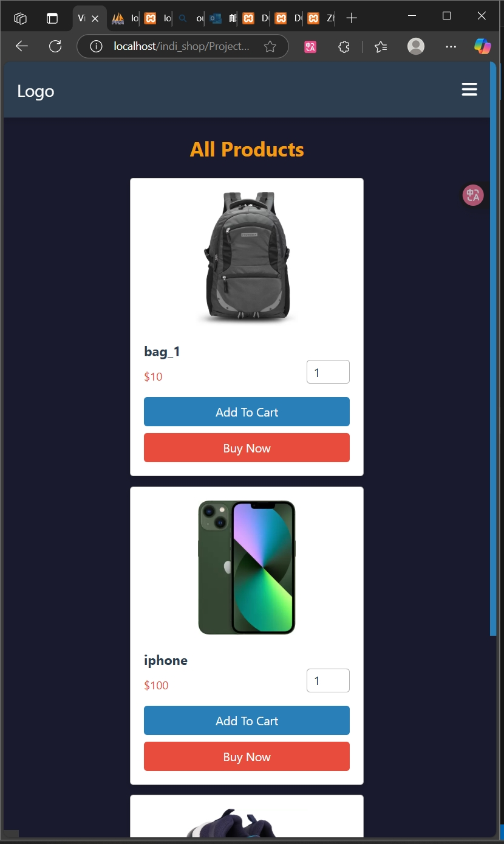
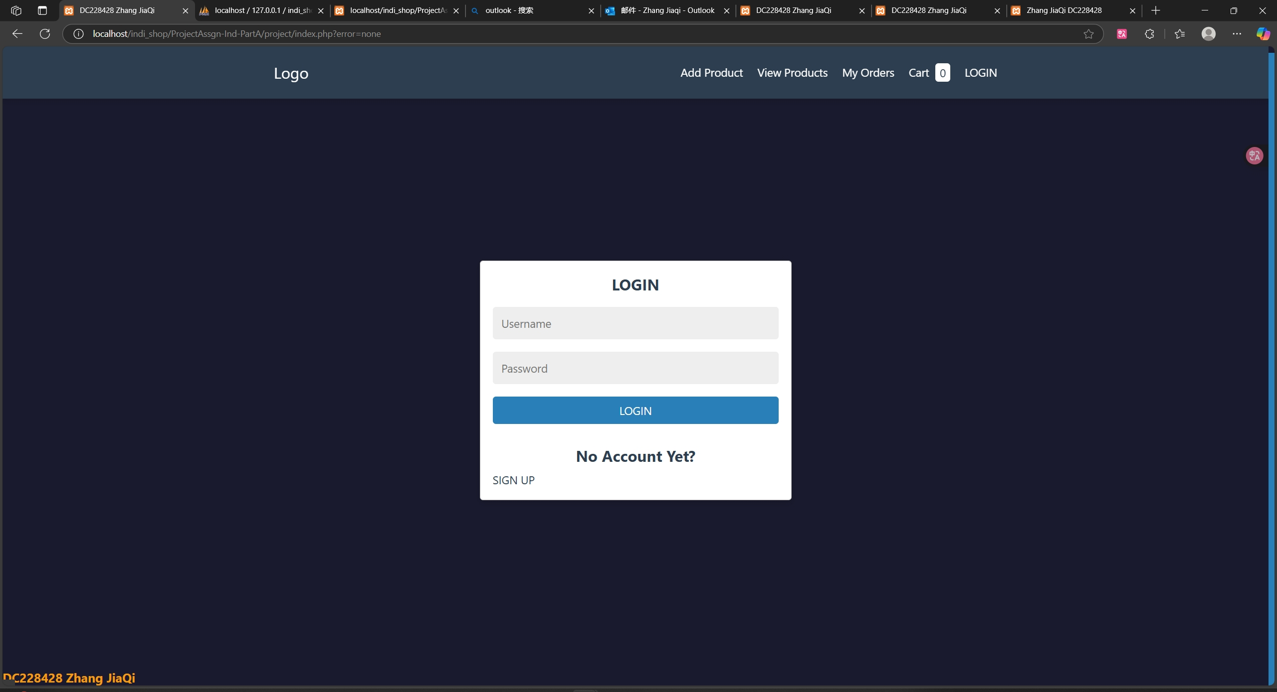
Individual Requirements Part A
Functions:
Manage products;
Manage shopping carts;
Manage accounts

Slide 3
Individual Requirements Part A
Location:
The file of the Nth exercise of part B is located in indi_shop/ProjectAssgn-Ind-PartA
Create a database:
Start MySQL through XAMPP, create a new database in phpMyAdmin (name it "indi_shop_db", sorting rule "utf8mb4_general_ci")
Import indi_shop/ProjectAssgn-Ind-PartA/createTable.sql and execute it.
Use:
Access localhost/indi_shop/ProjectAssgn-Ind-PartA/project/index.php through a browser

Slide 4
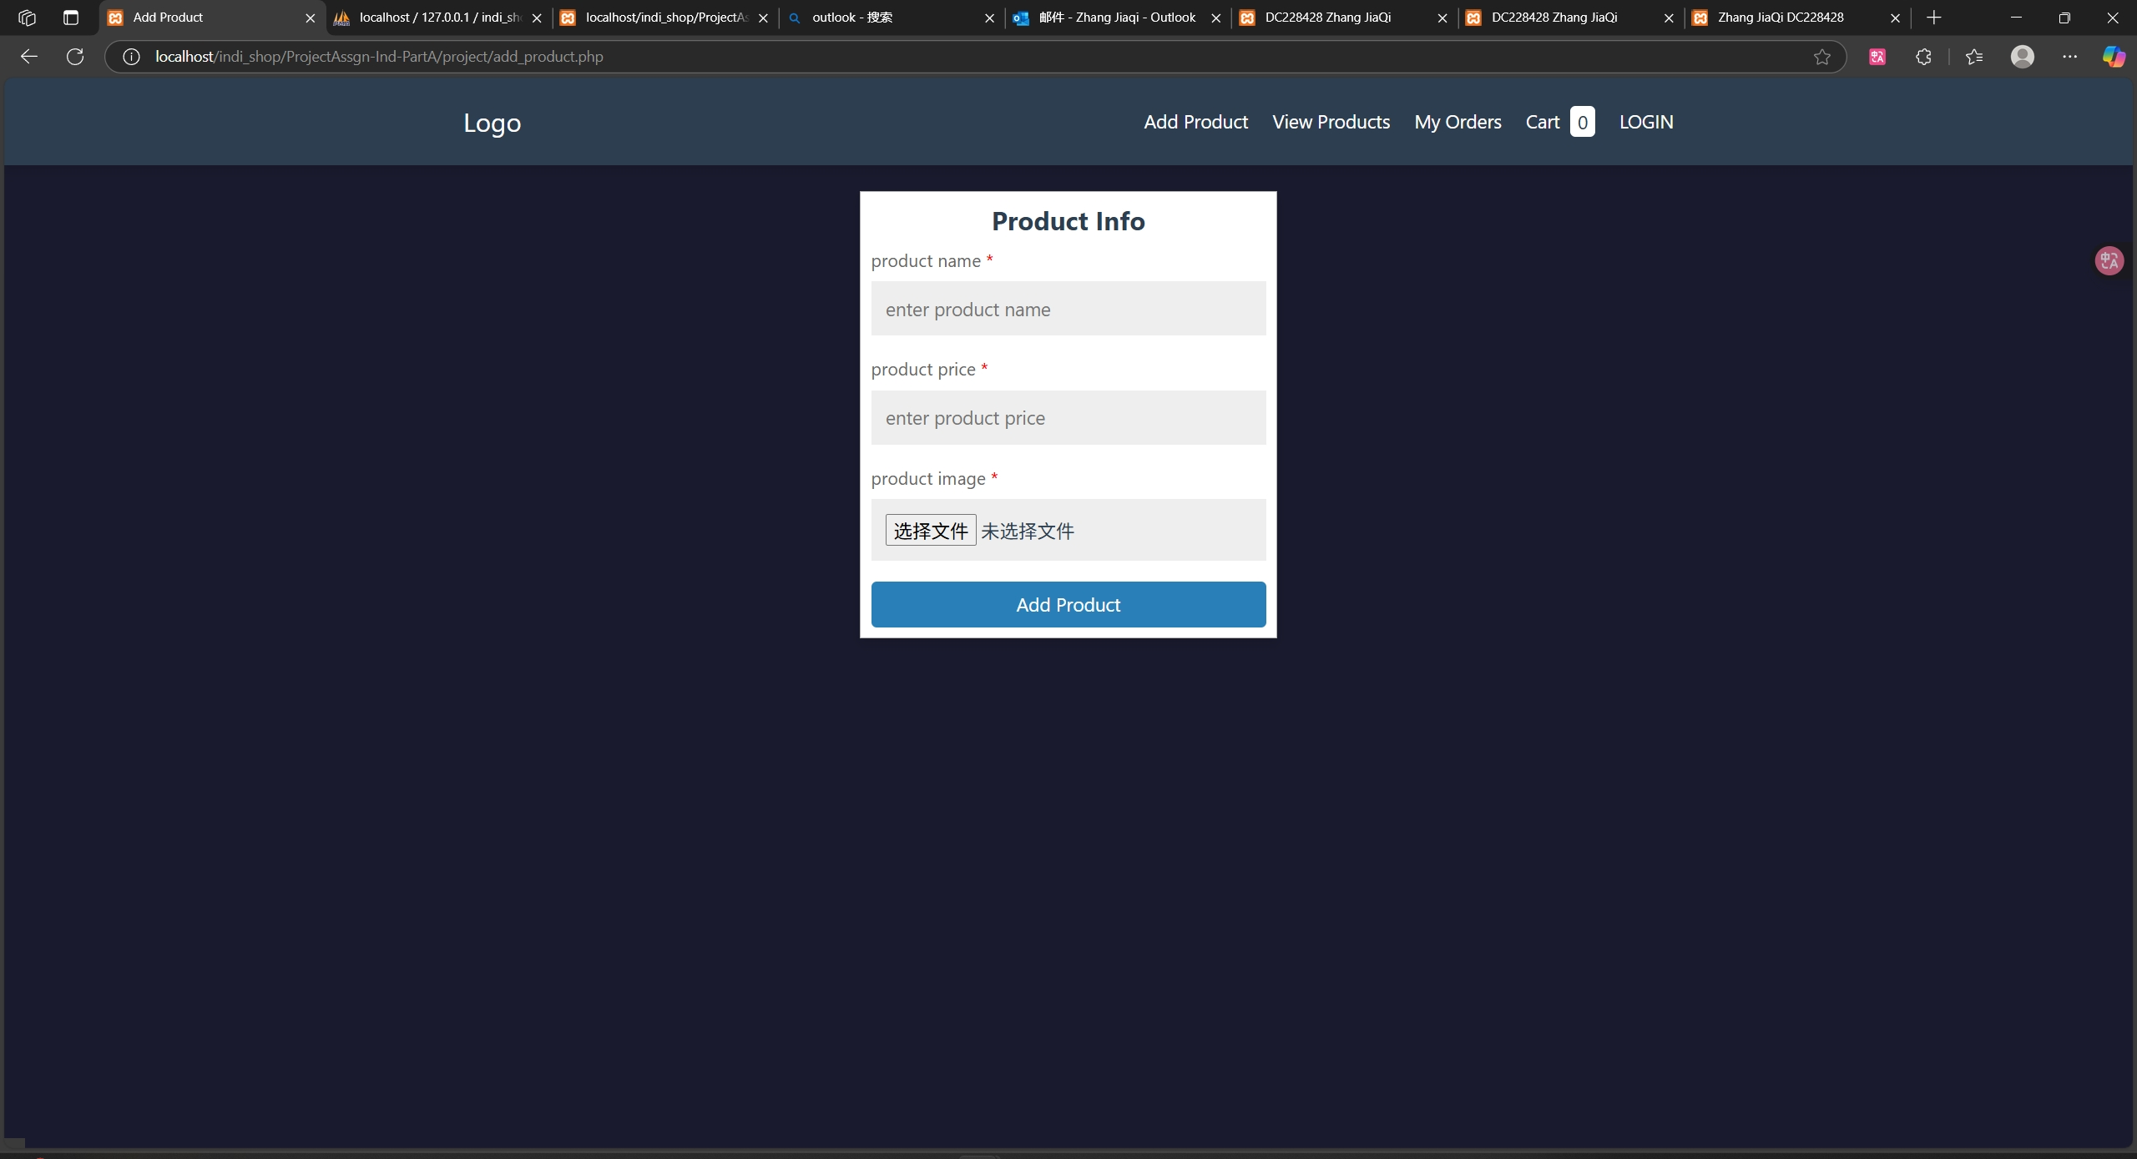
Individual Requirements Part A : Add product page

Slide 5
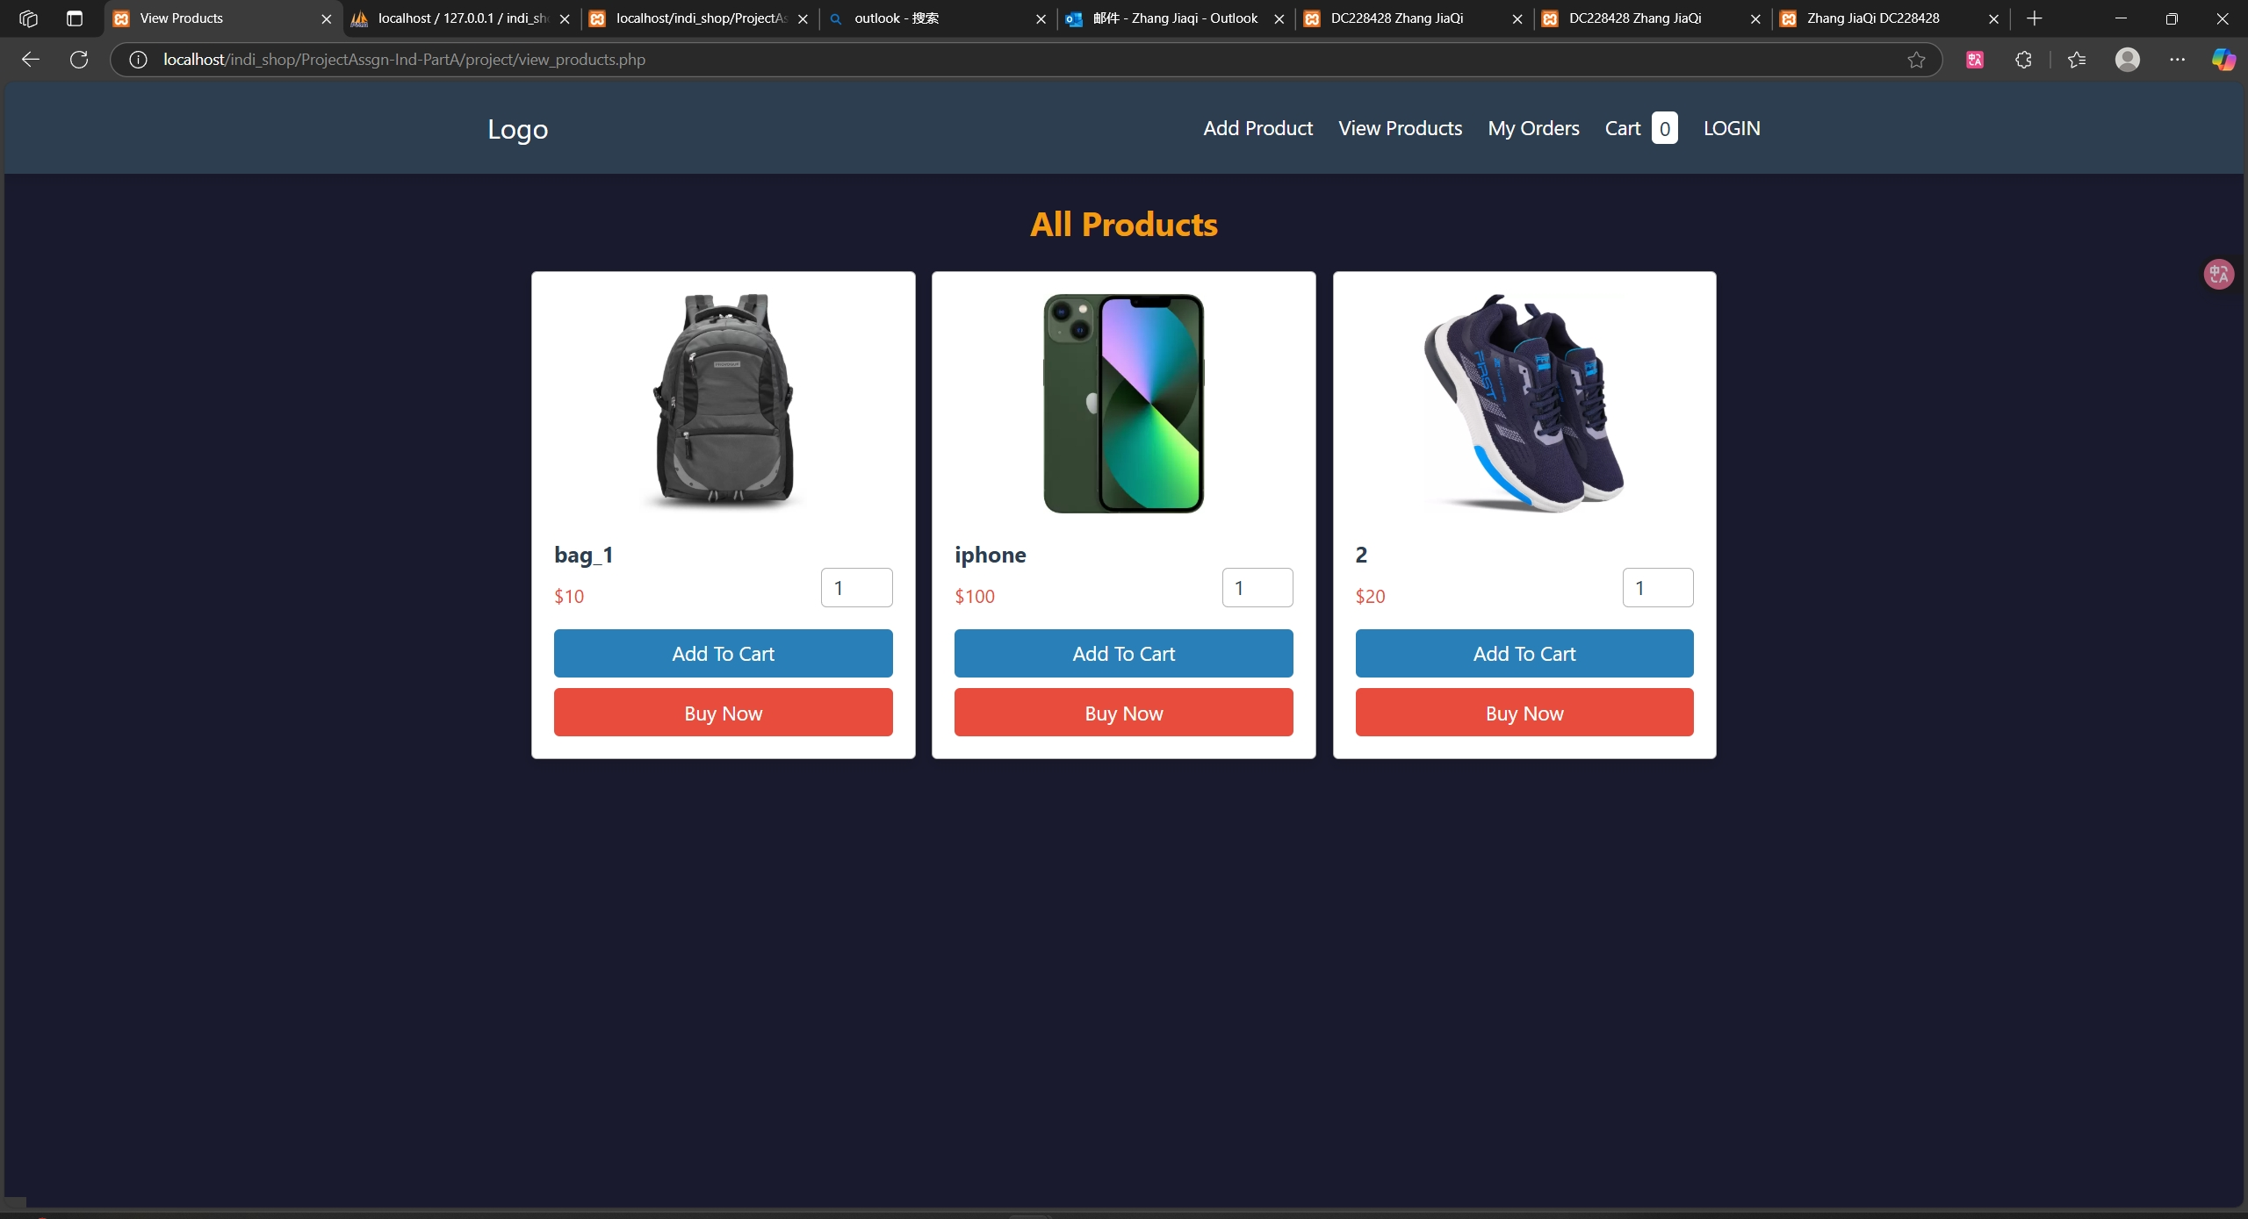
Individual Requirements Part A : View products page

Slide 6
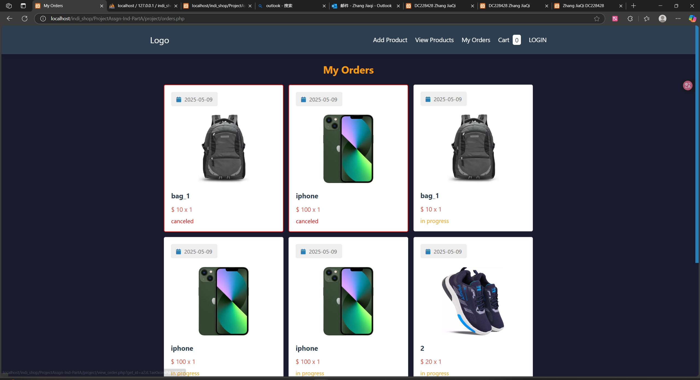
Individual Requirements Part A : Orders page

Slide 7
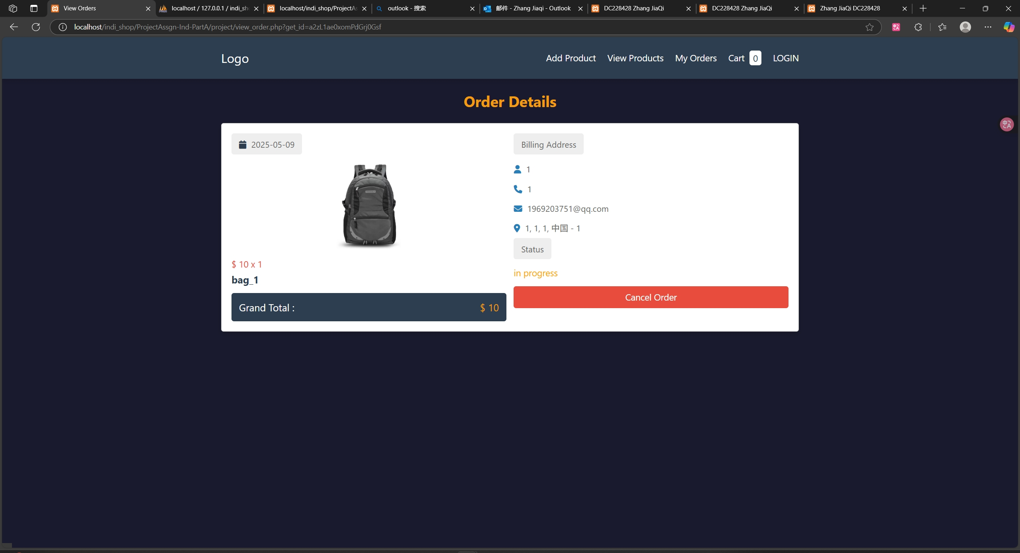
Individual Requirements Part A : Order detail page

Slide 8
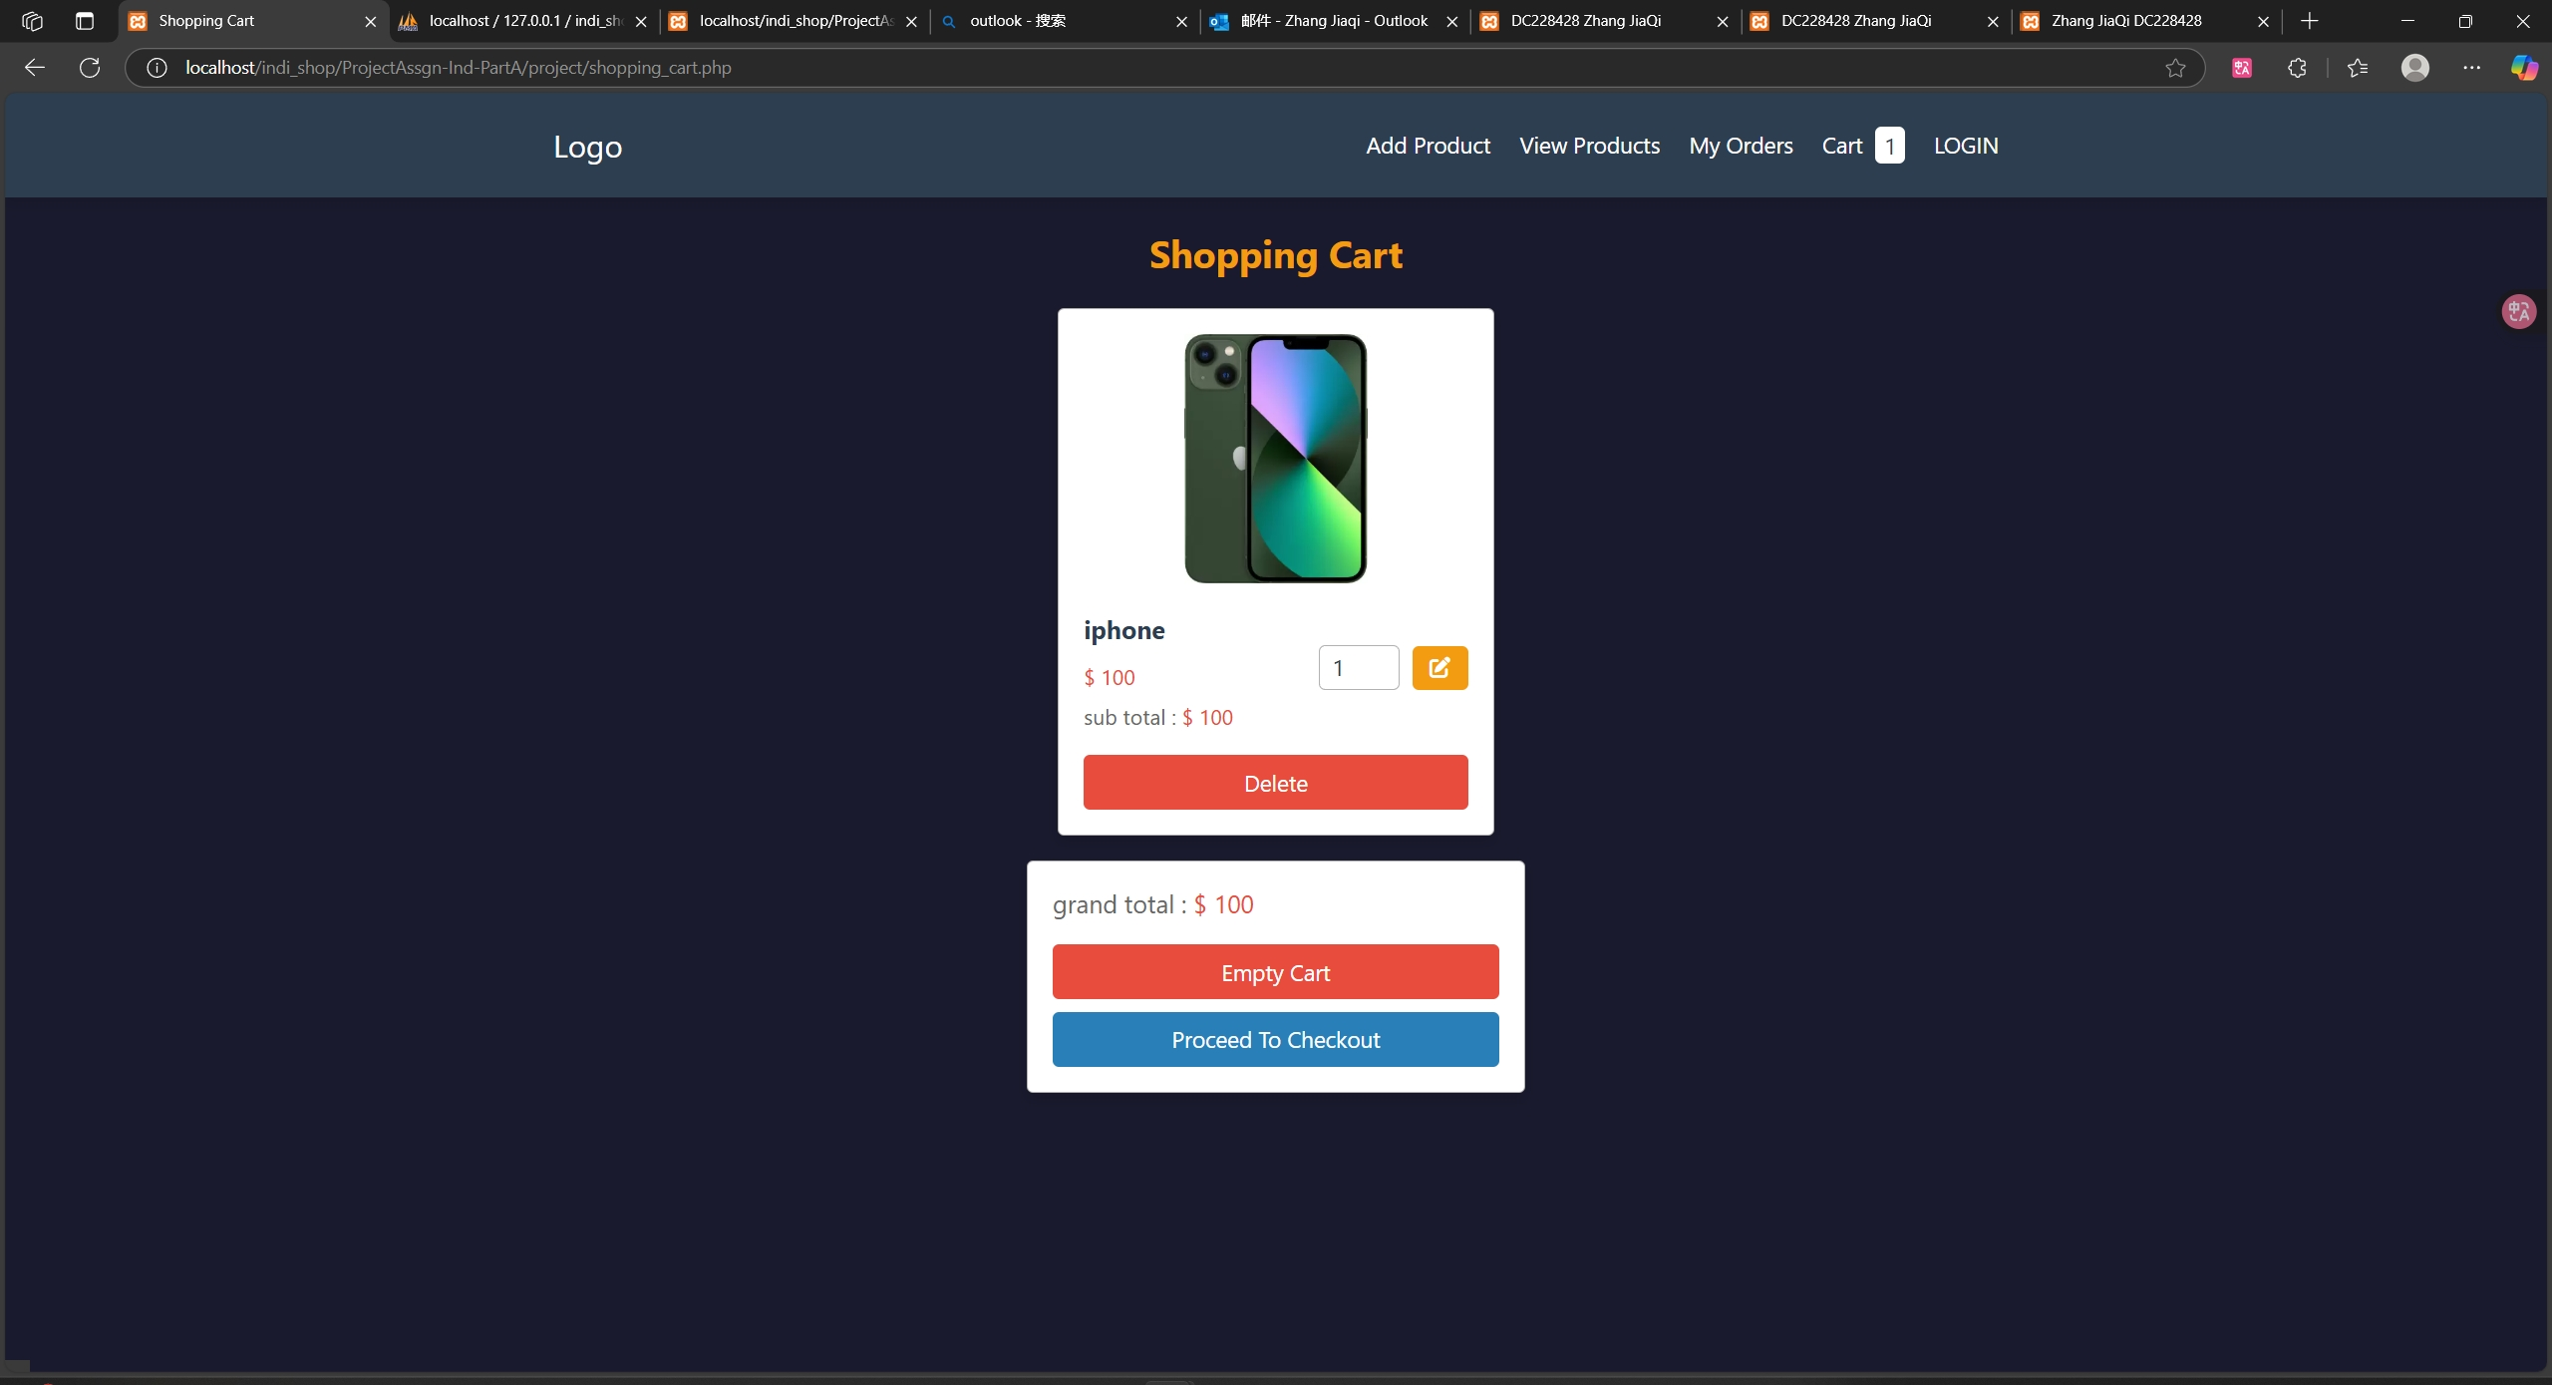
Individual Requirements Part A : Cart page

Slide 9
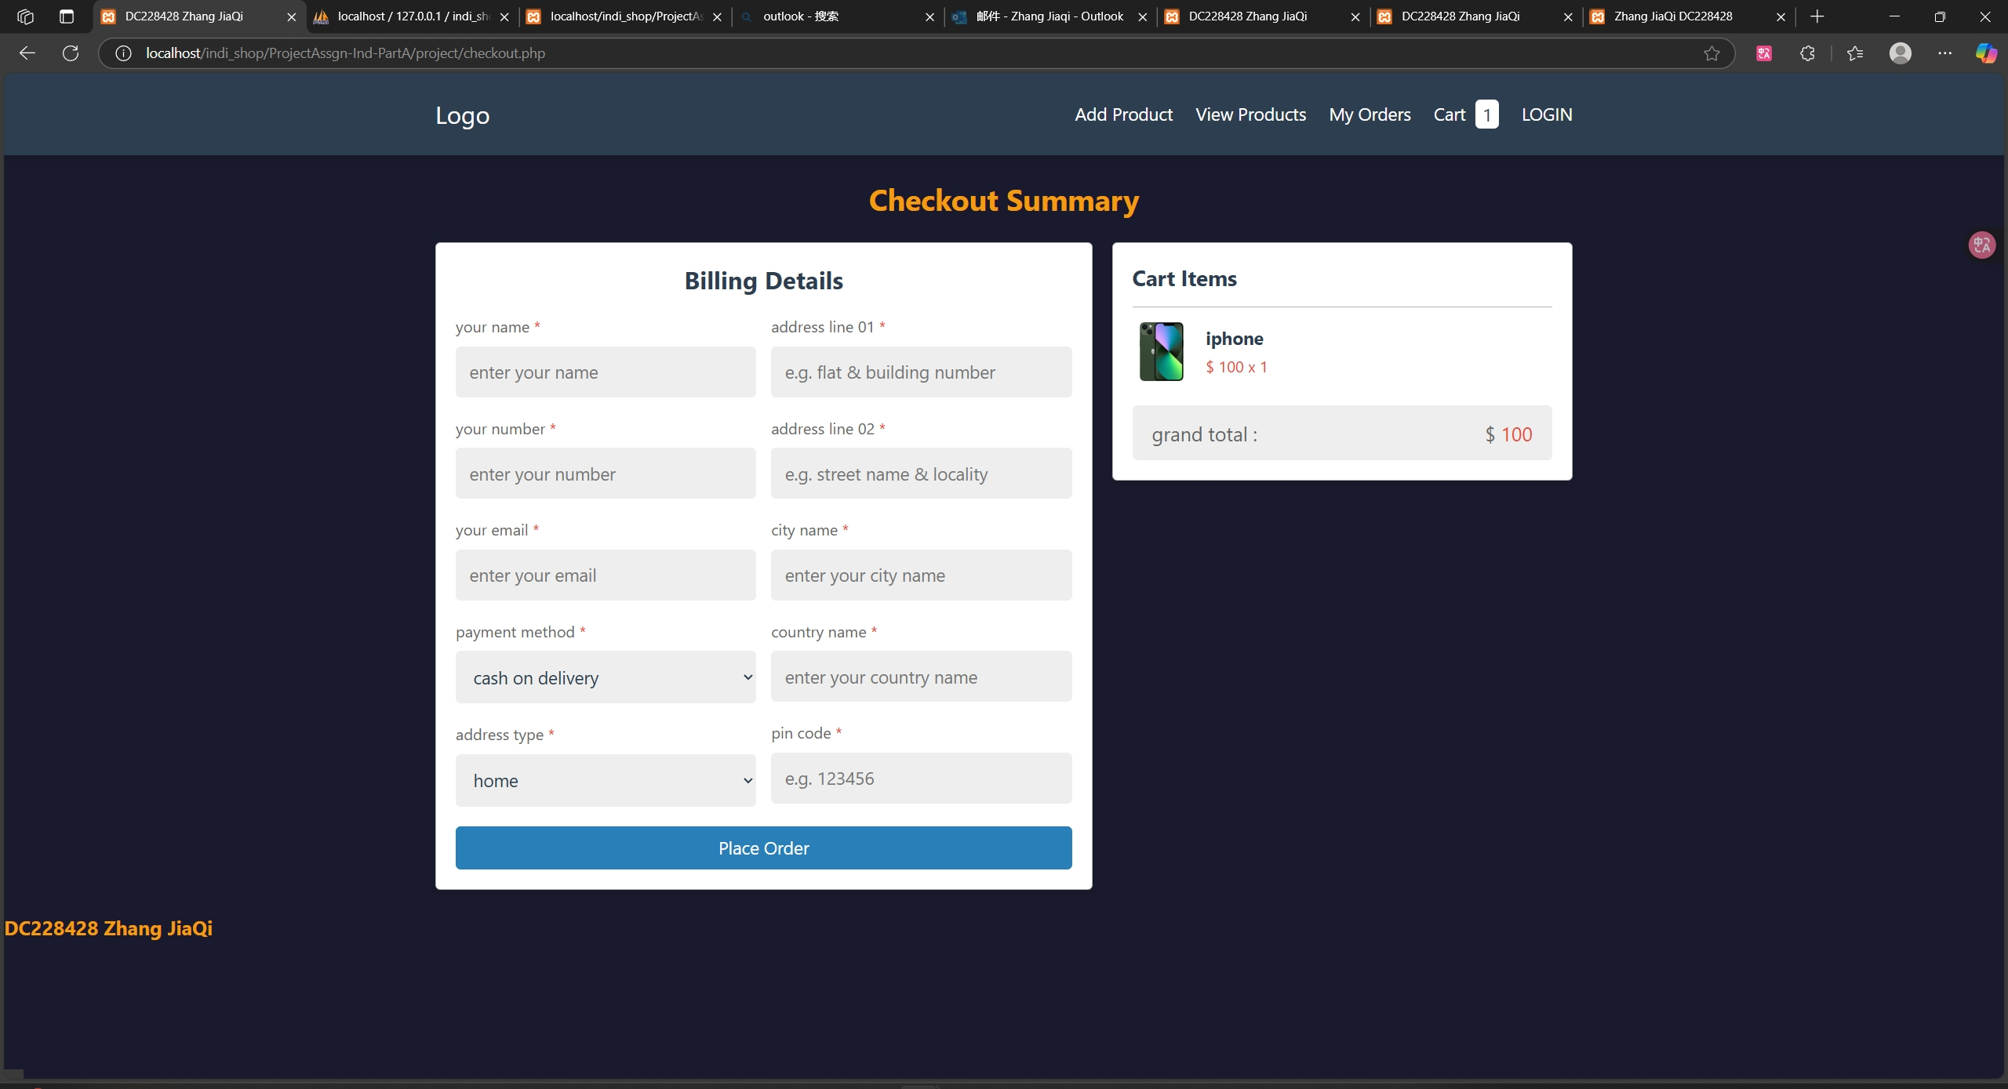
Individual Requirements Part A : checkout page

Slide 10
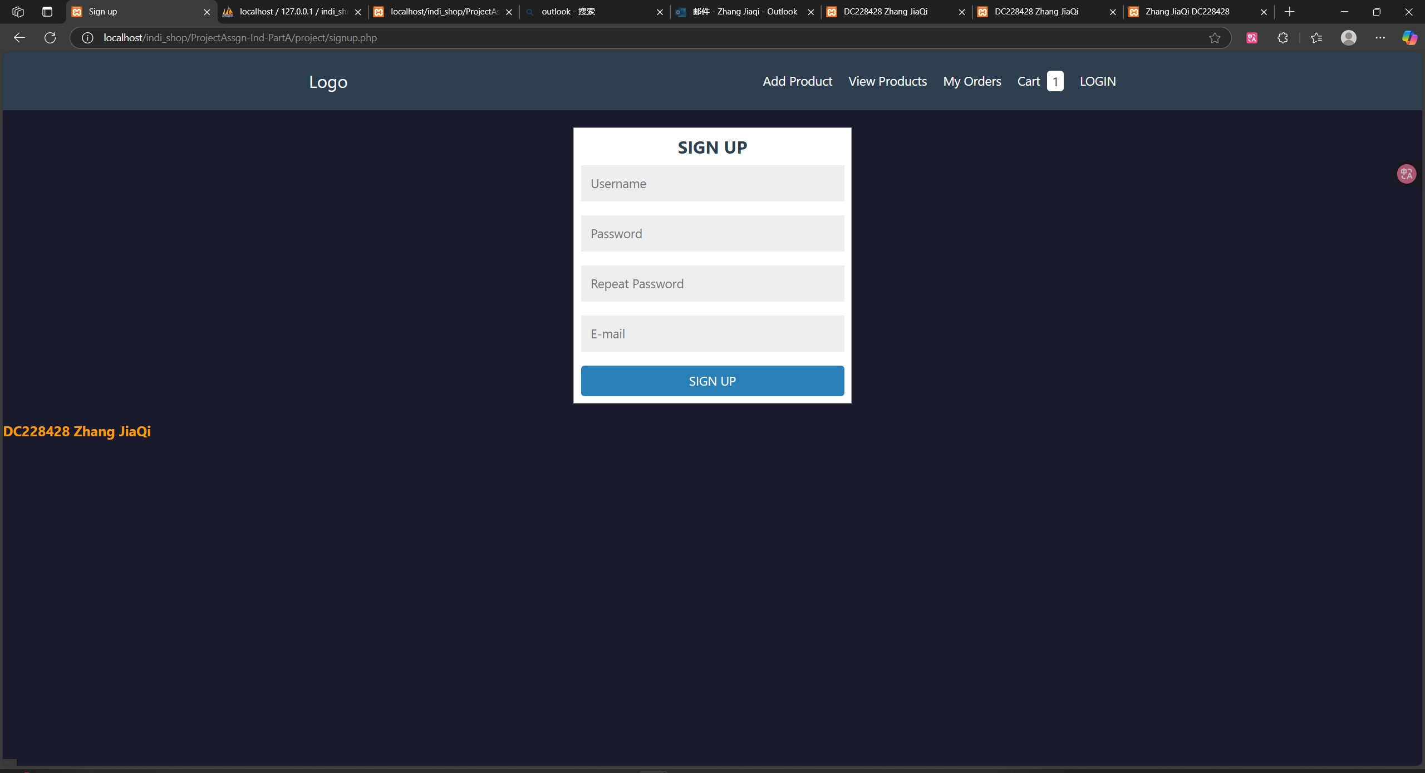
Individual Requirements Part A : Signup page

Slide 11
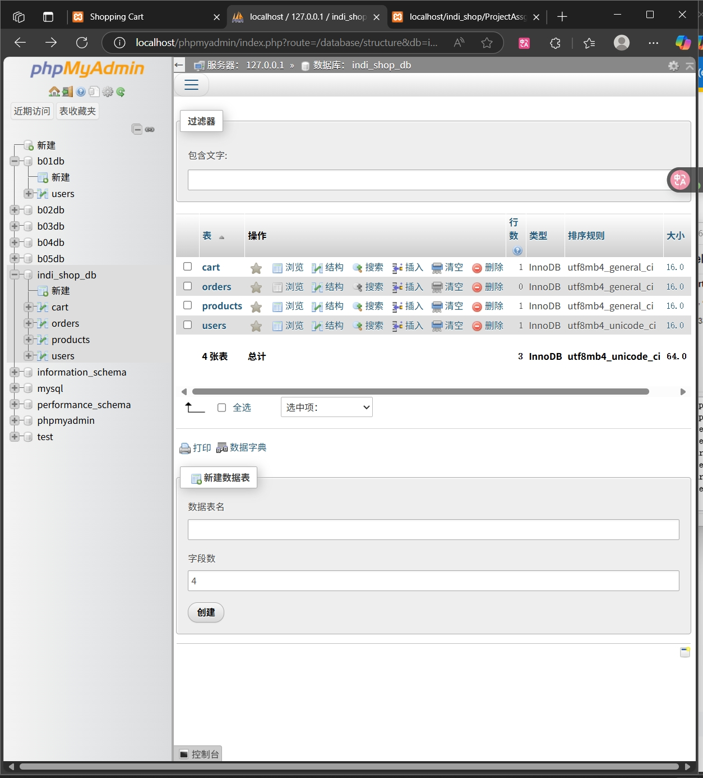
Individual Requirements Part A : Database: all tables

Slide 12
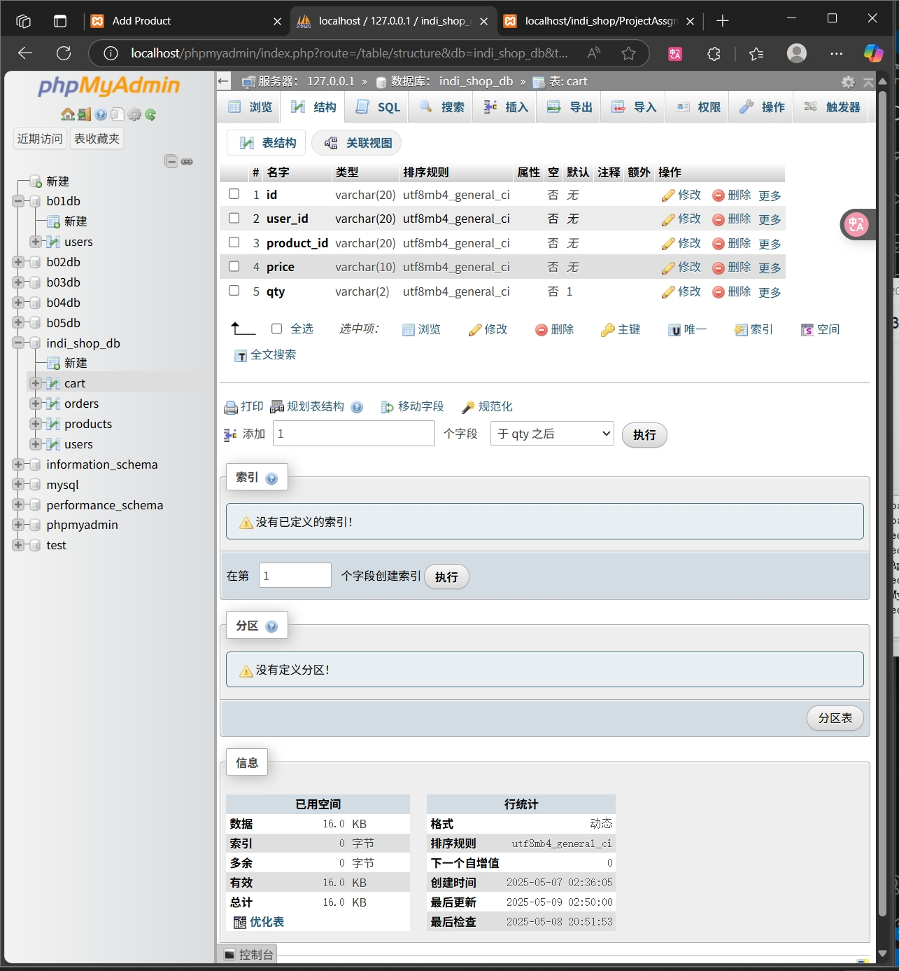
Individual Requirements Part A : Database: cart table attributes

Slide 13
Individual Requirements Part A : Database: cart table attributes

Slide 14
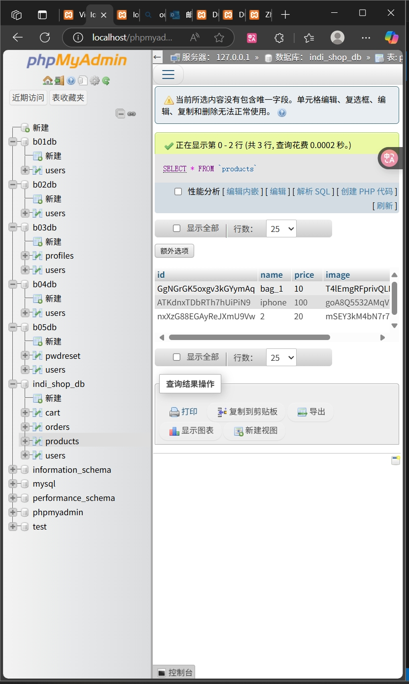
Individual Requirements Part A : Database: Product table entries

Slide 15
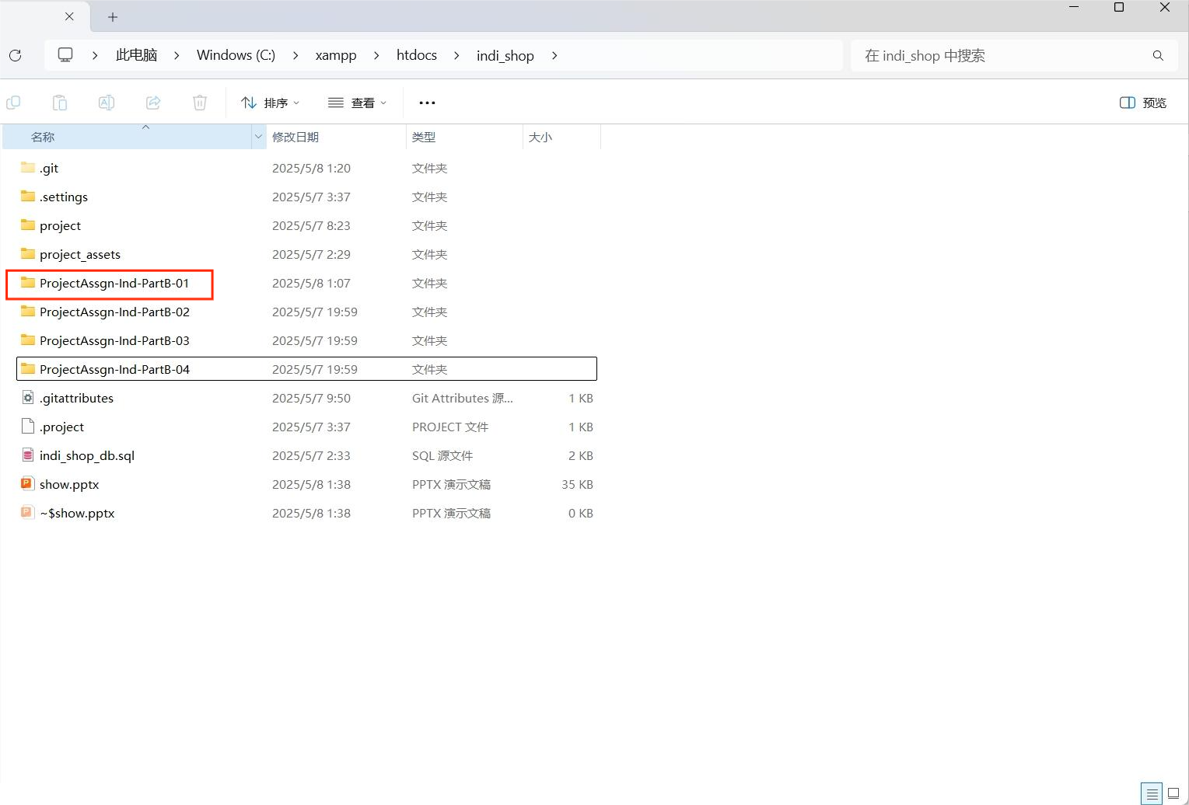
Individual Requirements Part B Practice 001
All files are located in indi_shop/ProjectAssgn-Ind-PartB-01
所有文件位于indi_shop/ProjectAssgn-Ind-PartB-01

Slide 16
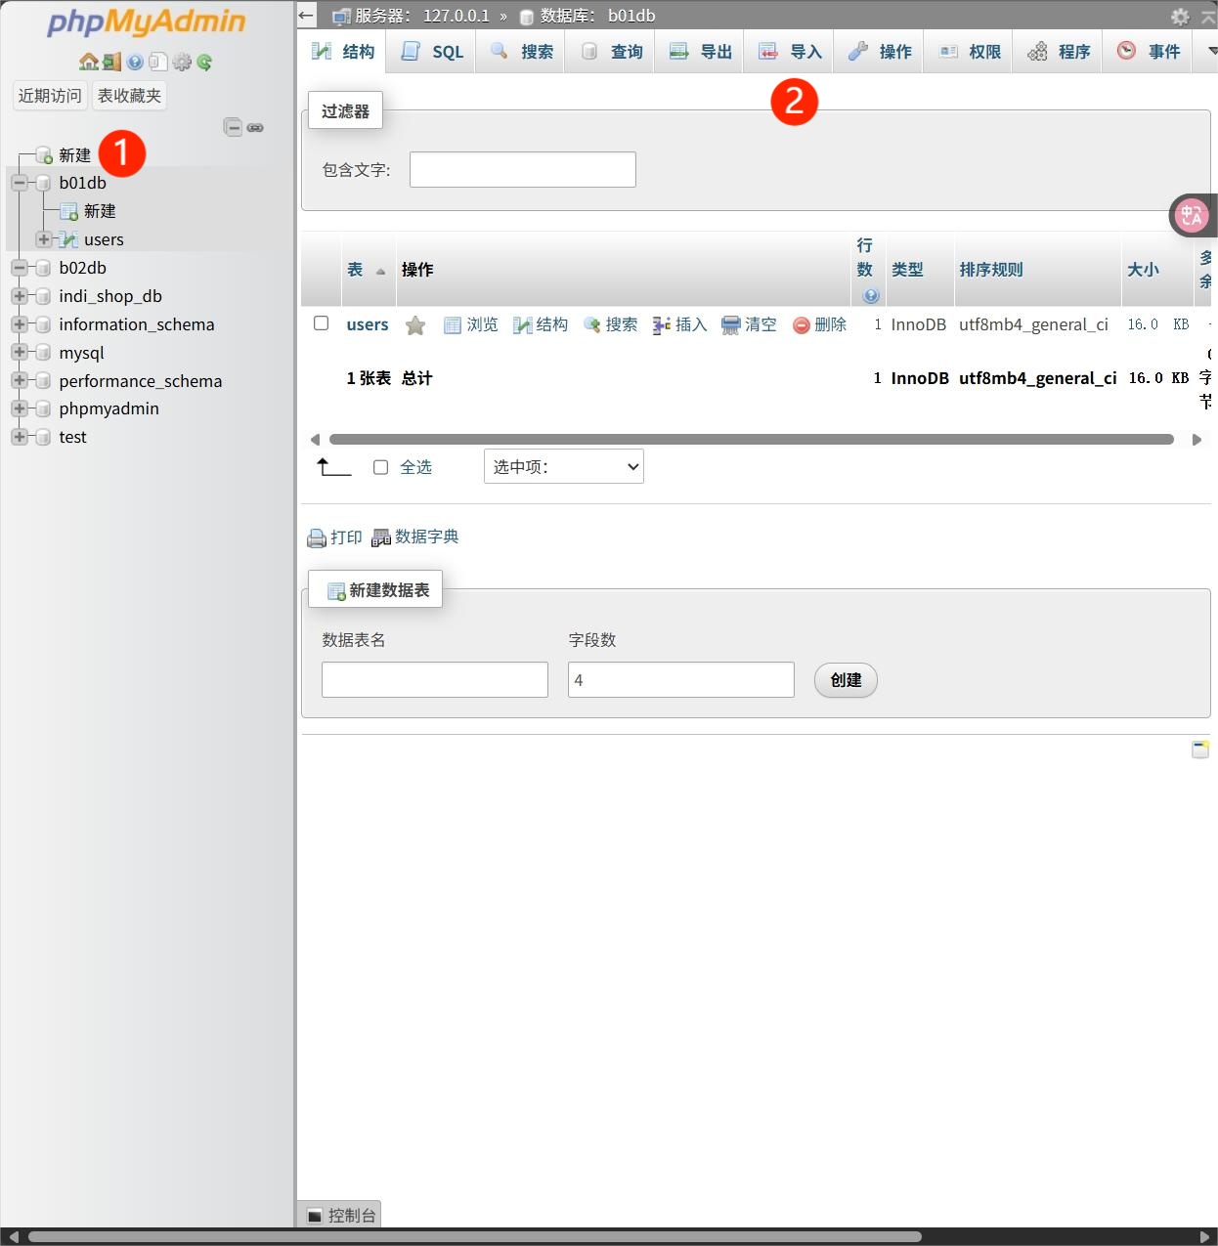
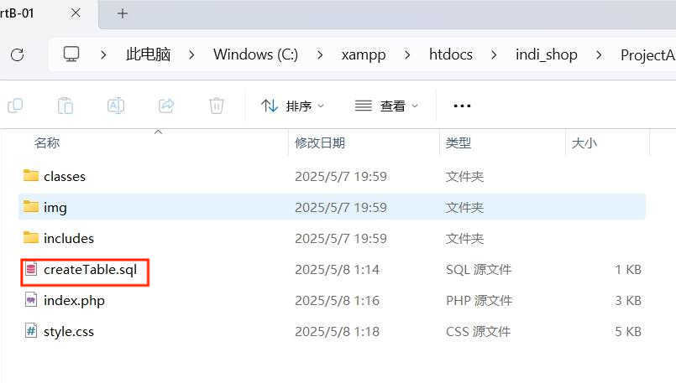
Individual Requirements Part B Practice 001 : Create database
All files are located in indi_shop/ProjectAssgn-Ind-PartB-01
Start MySQL through XAMPP, create a new database in phpMyAdmin (name it "b01db", collation "utf8mb4_general_ci")
To create the TABLE "users", import indi_shop/ProjectAssgn-Ind-PartB-01/createTable.sql and execute it.
所有文件位于indi_shop/ProjectAssgn-Ind-PartB-01
通过XAMPP启动MySQL,在phpMyAdmin中新建数据库（命名为“b01db”，排序规则“utf8mb4_general_ci”）
为了创建TABLE “users”, 导入indi_shop/ProjectAssgn-Ind-PartB-01/createTable.sql并执行.

Slide 17
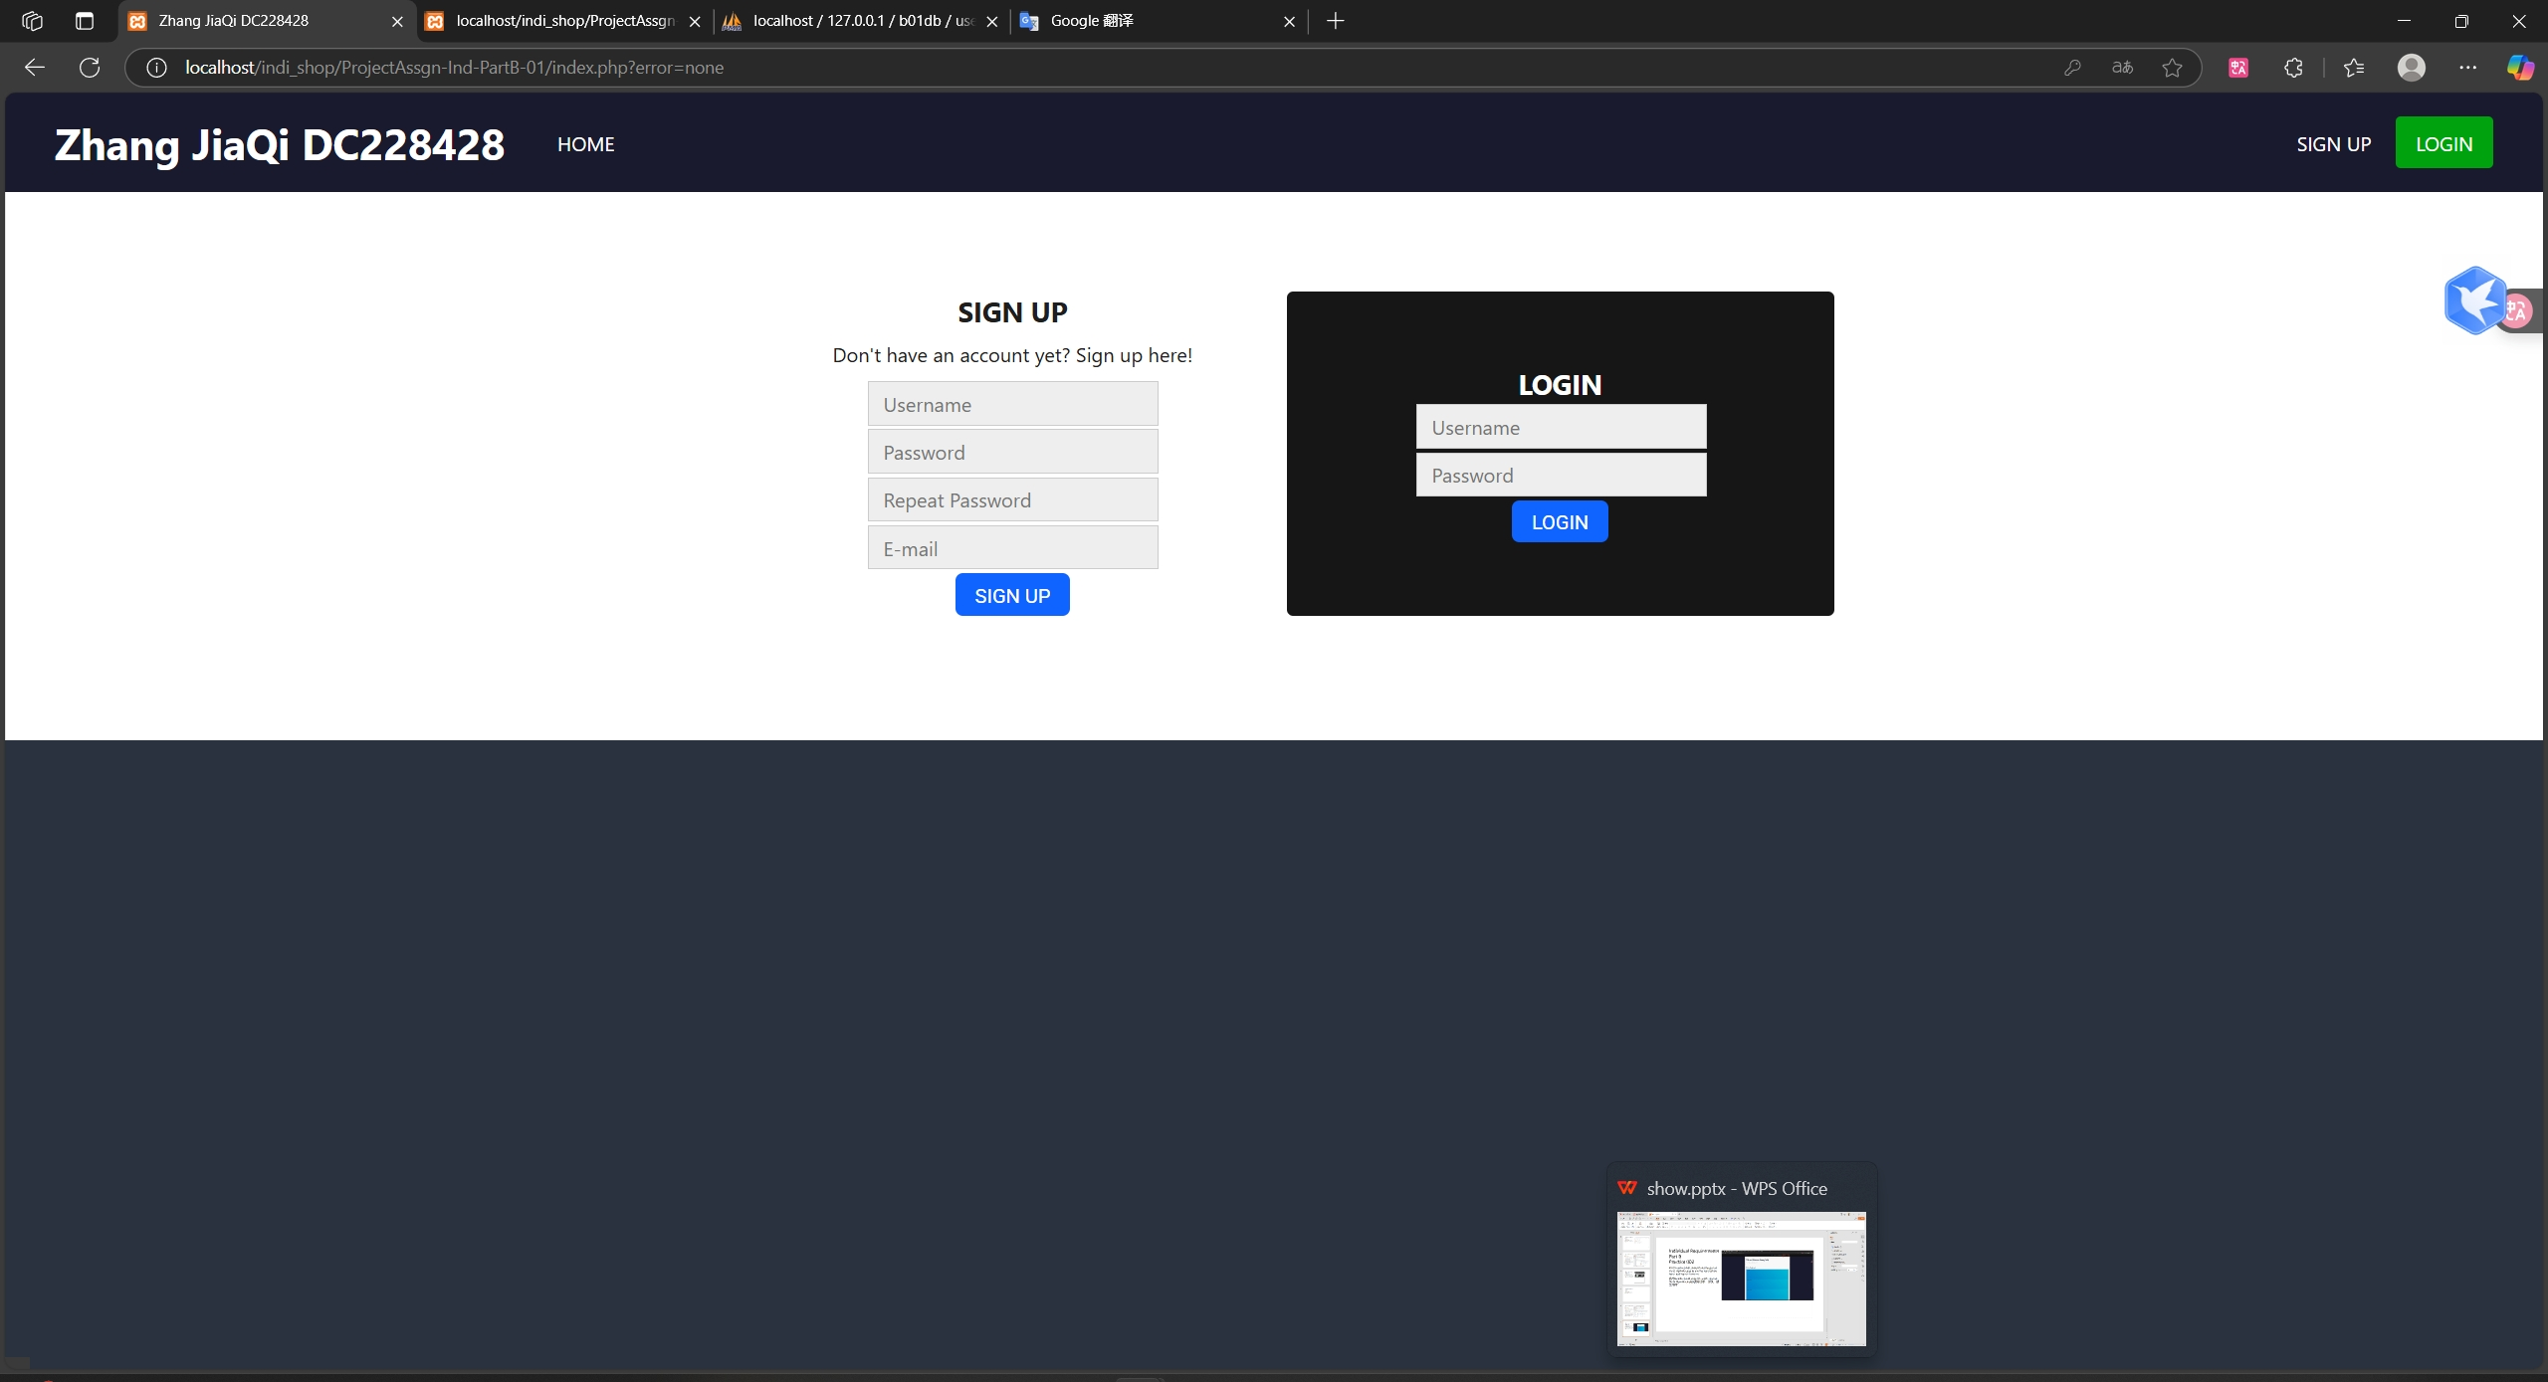
Individual Requirements Part B Practice 001
Visit localhost/indi_shop/ProjectAssgn-Ind-PartB-01/index.php to use the registration, login, and logout functions
访问localhost/indi_shop/ProjectAssgn-Ind-PartB-01/index.php以使用注册，登录，登出功能

Slide 18
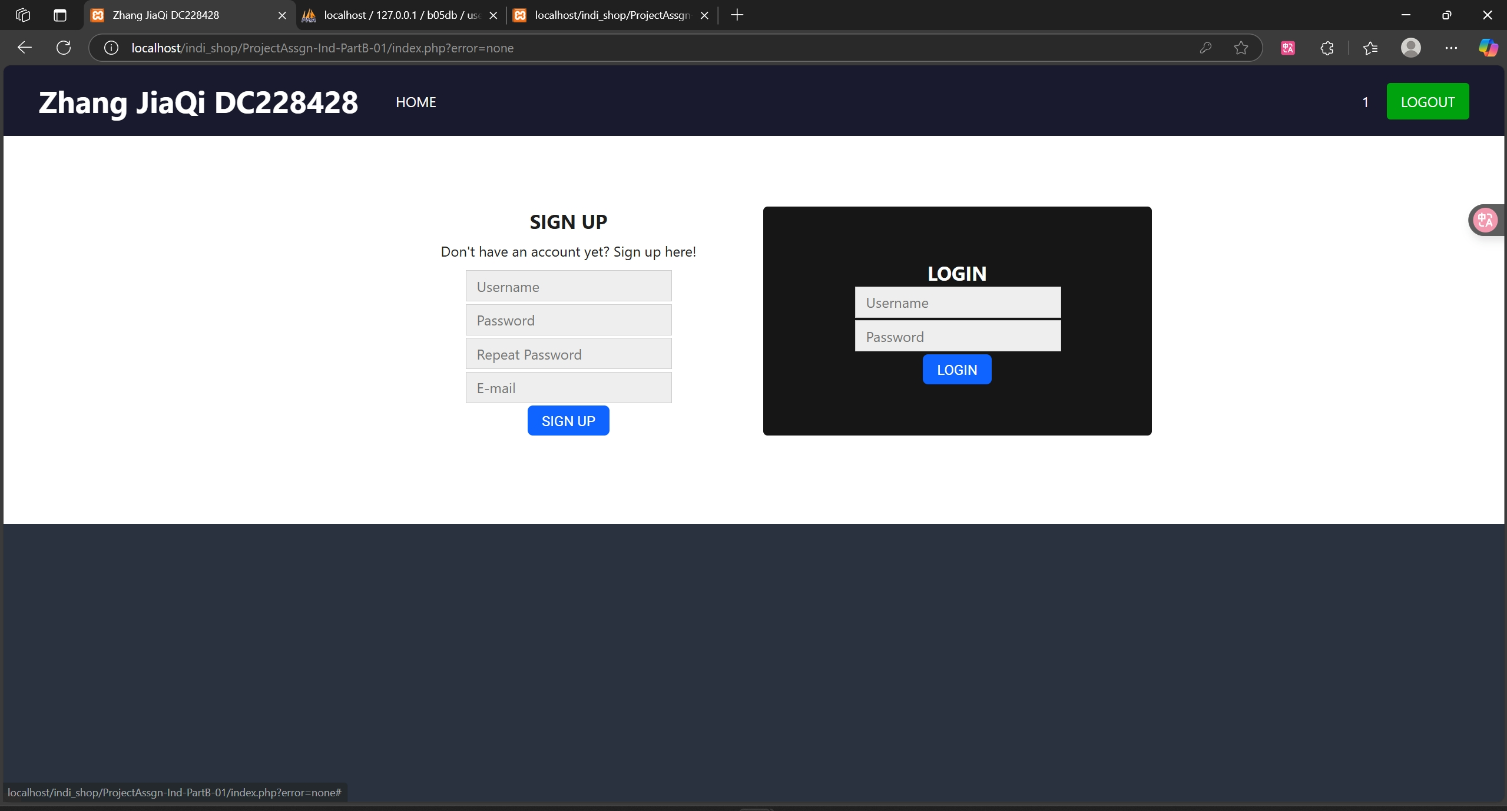
Individual Requirements Part B Practice 001 : Logged in page

Slide 19
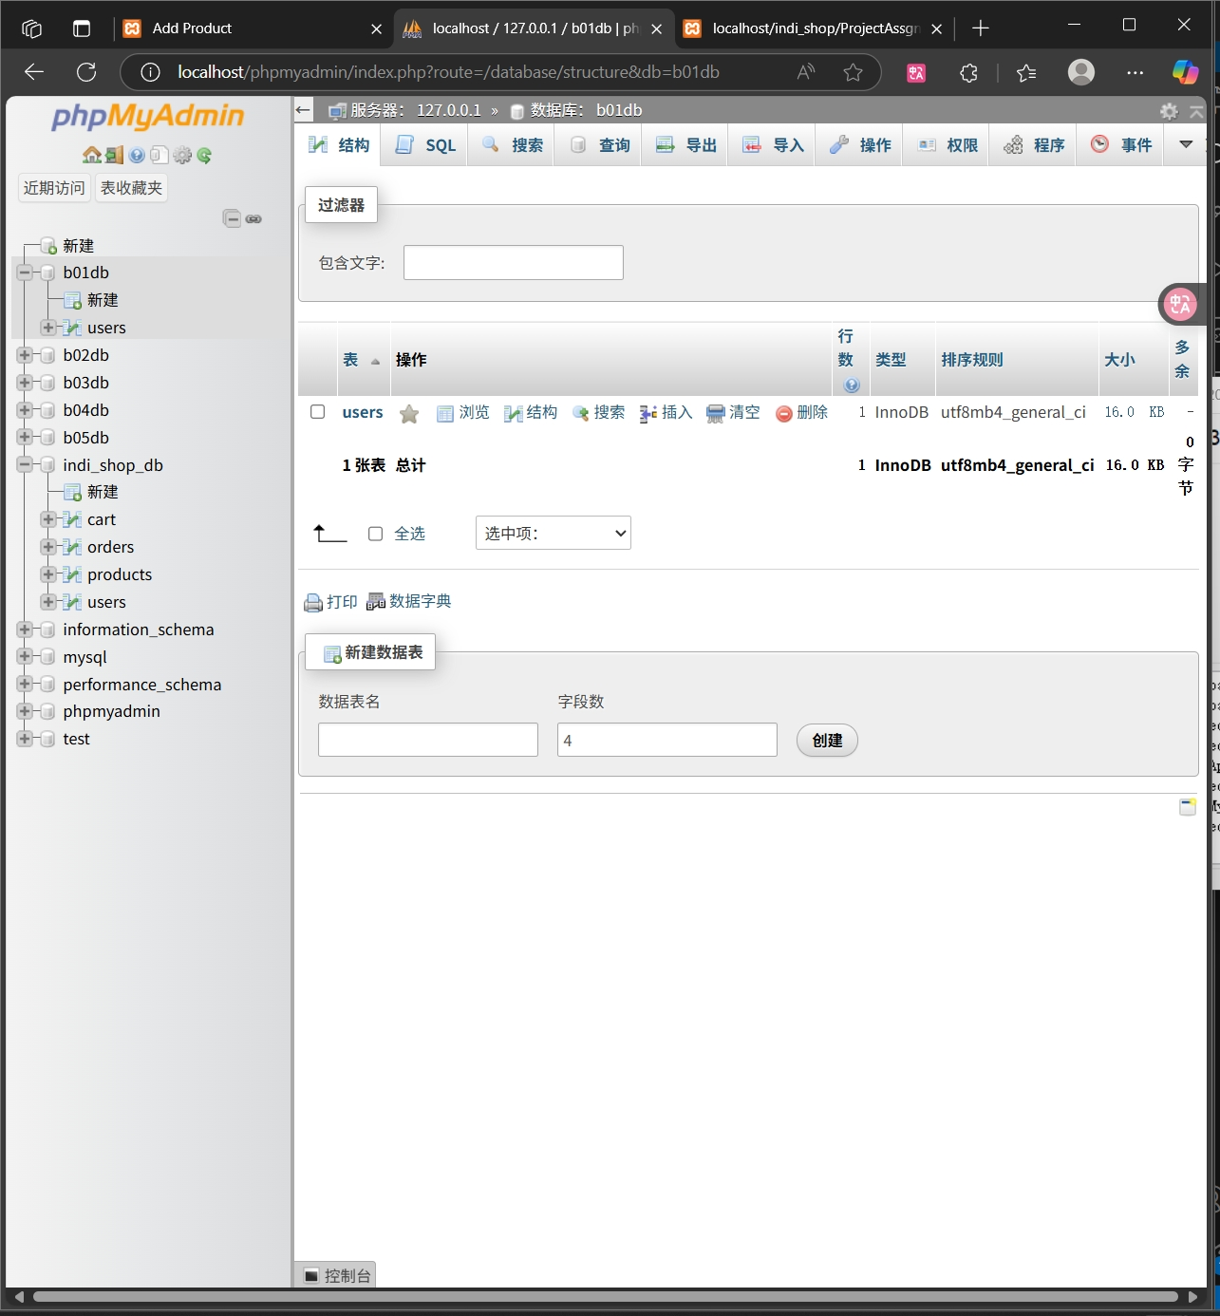
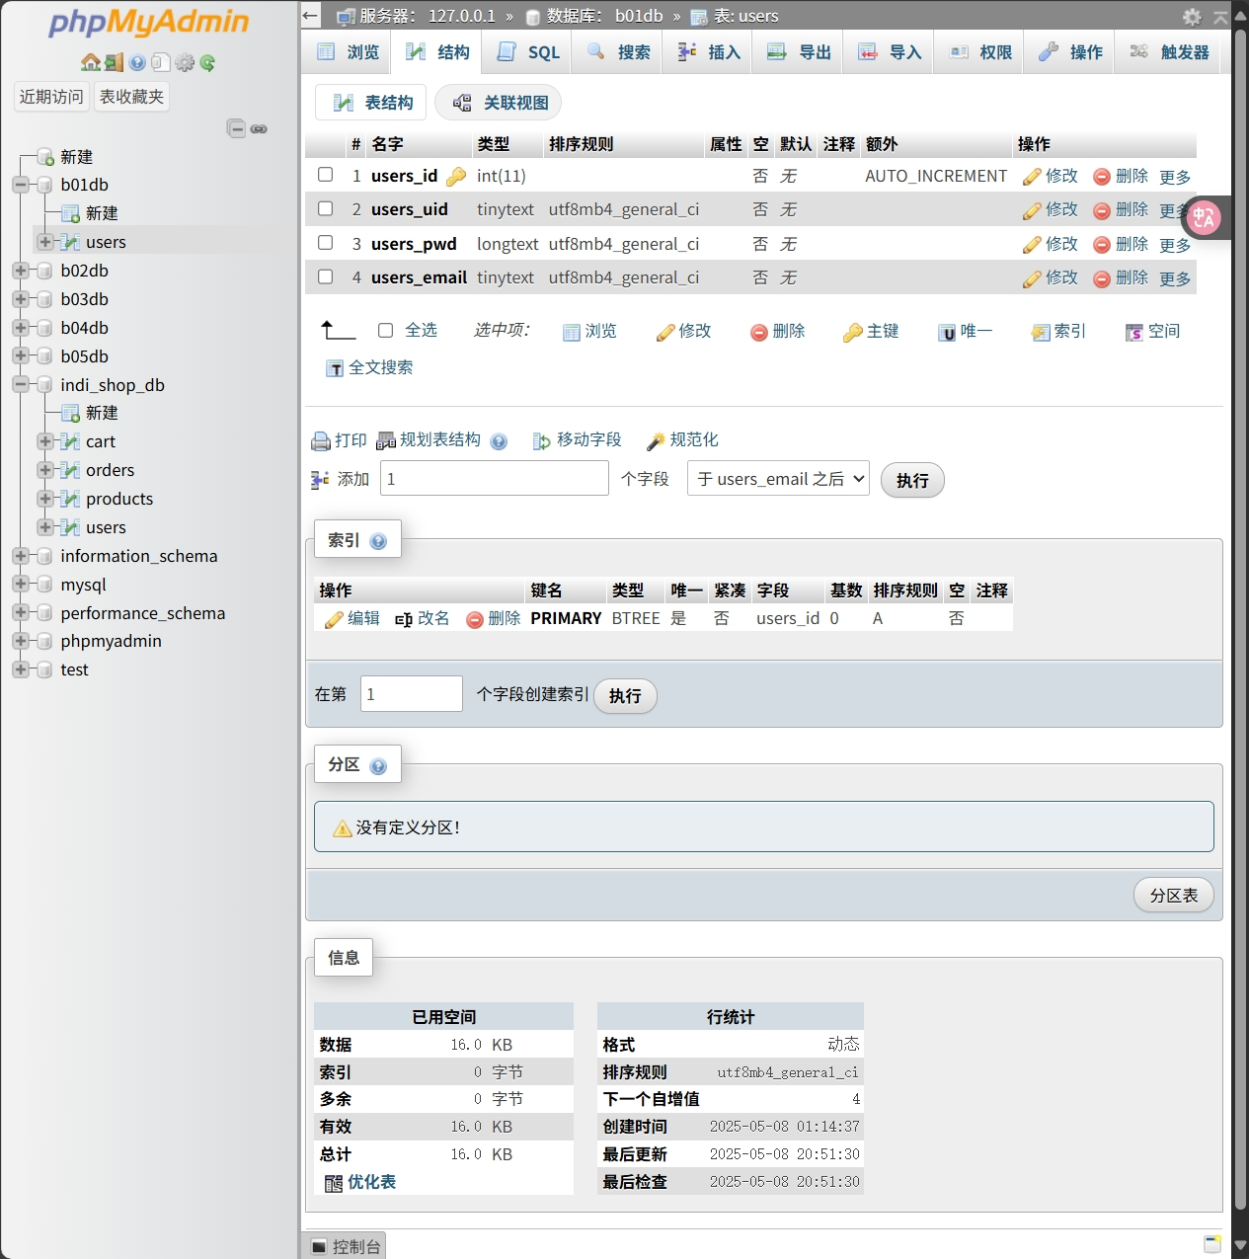
Individual Requirements Part B Practice 001 : Database

Slide 20
Individual Requirements Part B Practice 002
All files are located in indi_shop/ProjectAssgn-Ind-PartB-02
所有文件位于indi_shop/ProjectAssgn-Ind-PartB-02

Slide 21
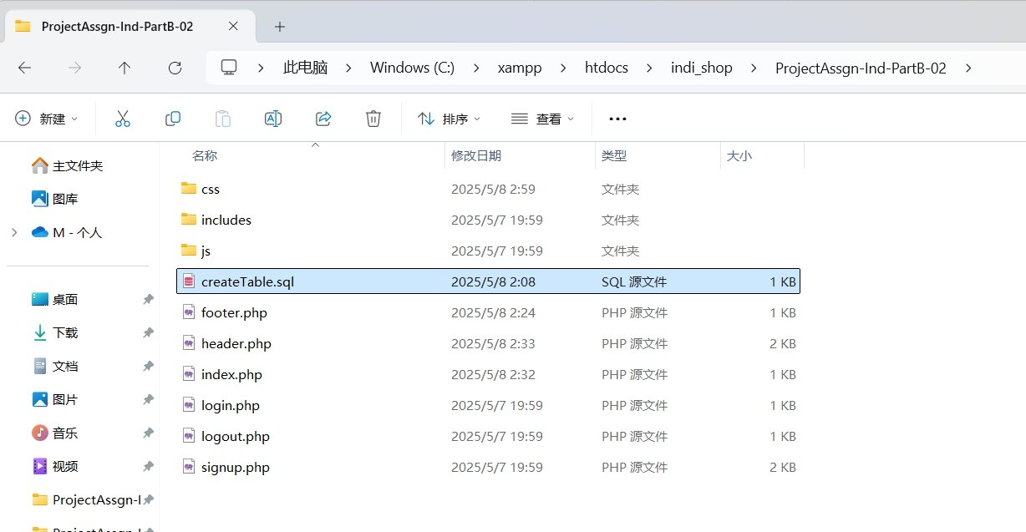
Individual Requirements Part B Practice 002
All files are located in indi_shop/ProjectAssgn-Ind-PartB-02
Start MySQL through XAMPP, create a new database in phpMyAdmin (name it "b02db", collation "utf8mb4_general_ci")
Import indi_shop/ProjectAssgn-Ind-PartB-02/createTable.sql and execute it.
所有文件位于indi_shop/ProjectAssgn-Ind-PartB-02
通过XAMPP启动MySQL,在phpMyAdmin中新建数据库（命名为“b02db”，排序规则“utf8mb4_general_ci”）
导入indi_shop/ProjectAssgn-Ind-PartB-02/createTable.sql并执行.

Slide 22
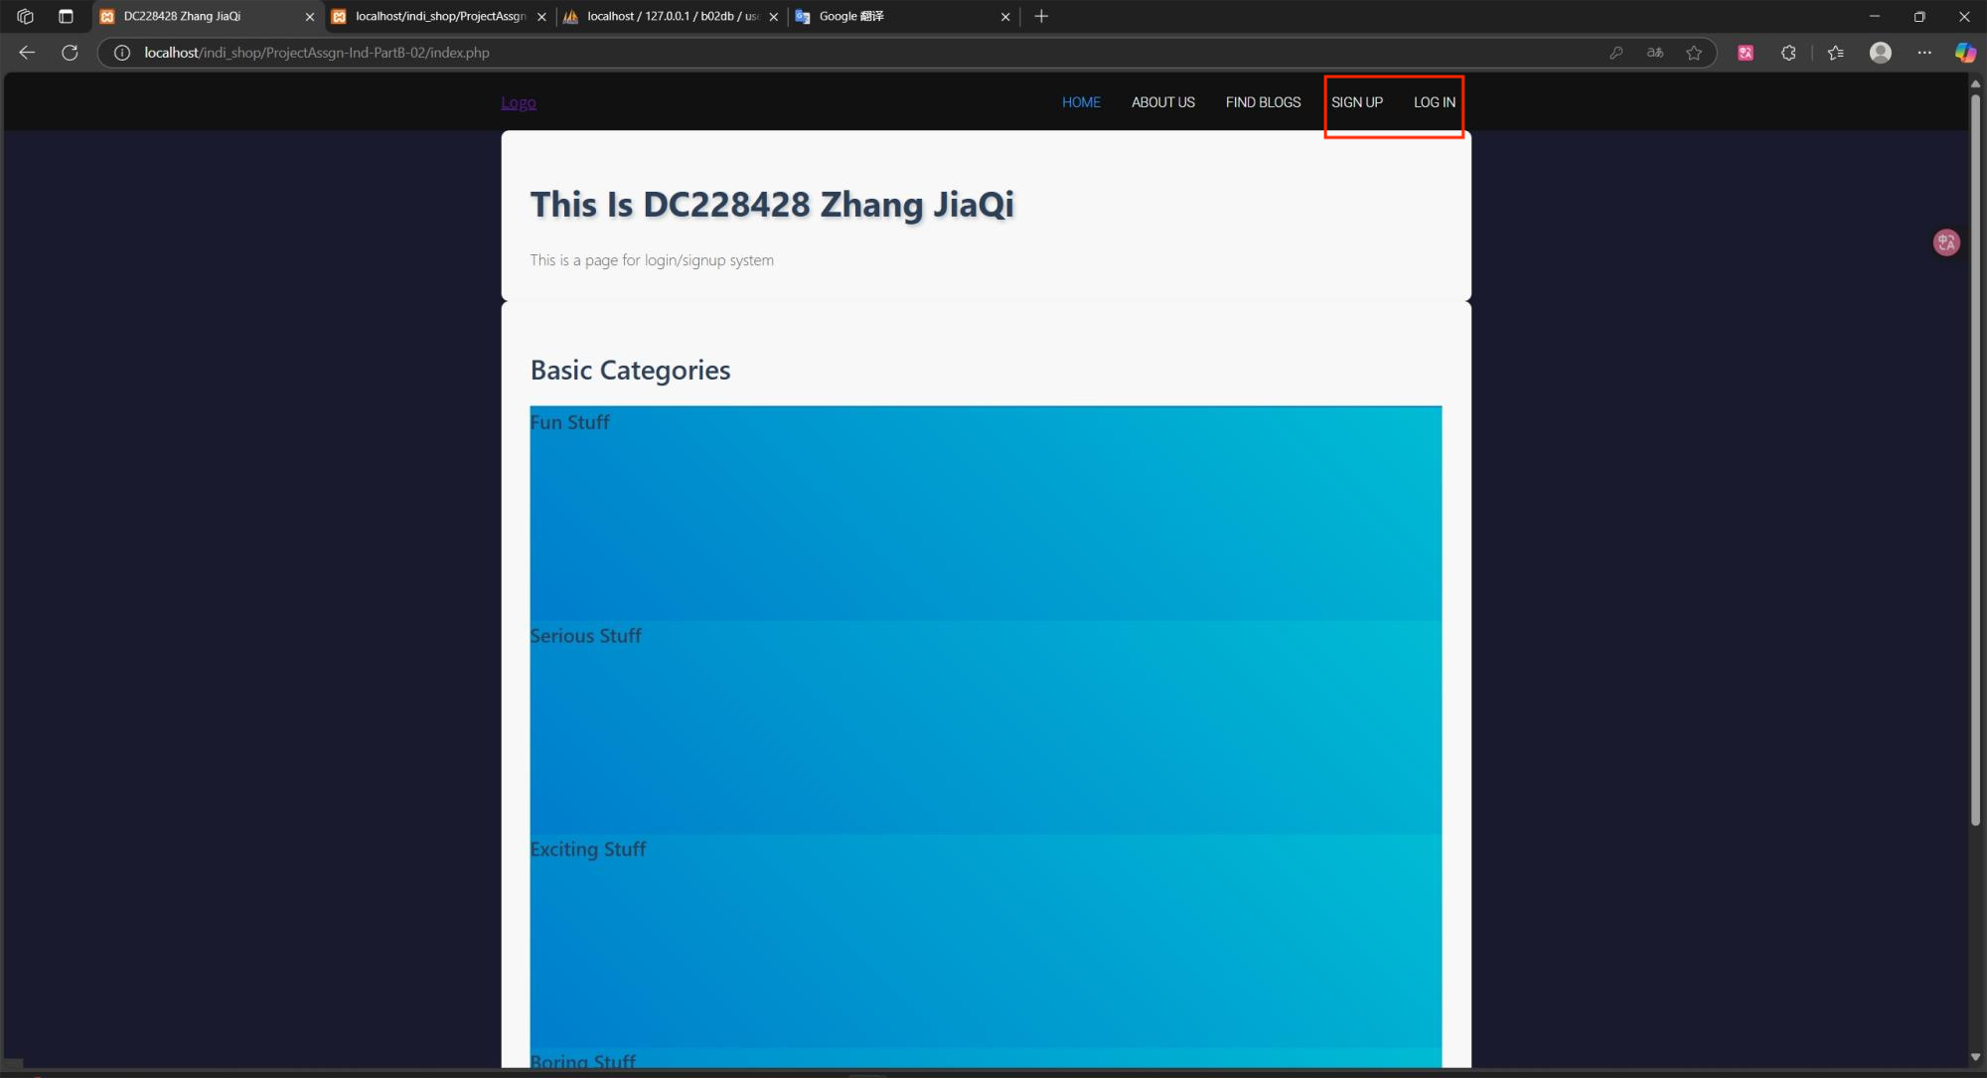
Individual Requirements Part B Practice 002
Visit localhost/indi_shop/ProjectAssgn-Ind-PartB-02/index.php to use the registration, login, and logout functions
访问localhost/indi_shop/ProjectAssgn-Ind-PartB-02/index.php以使用注册，登录，登出功能

Slide 23
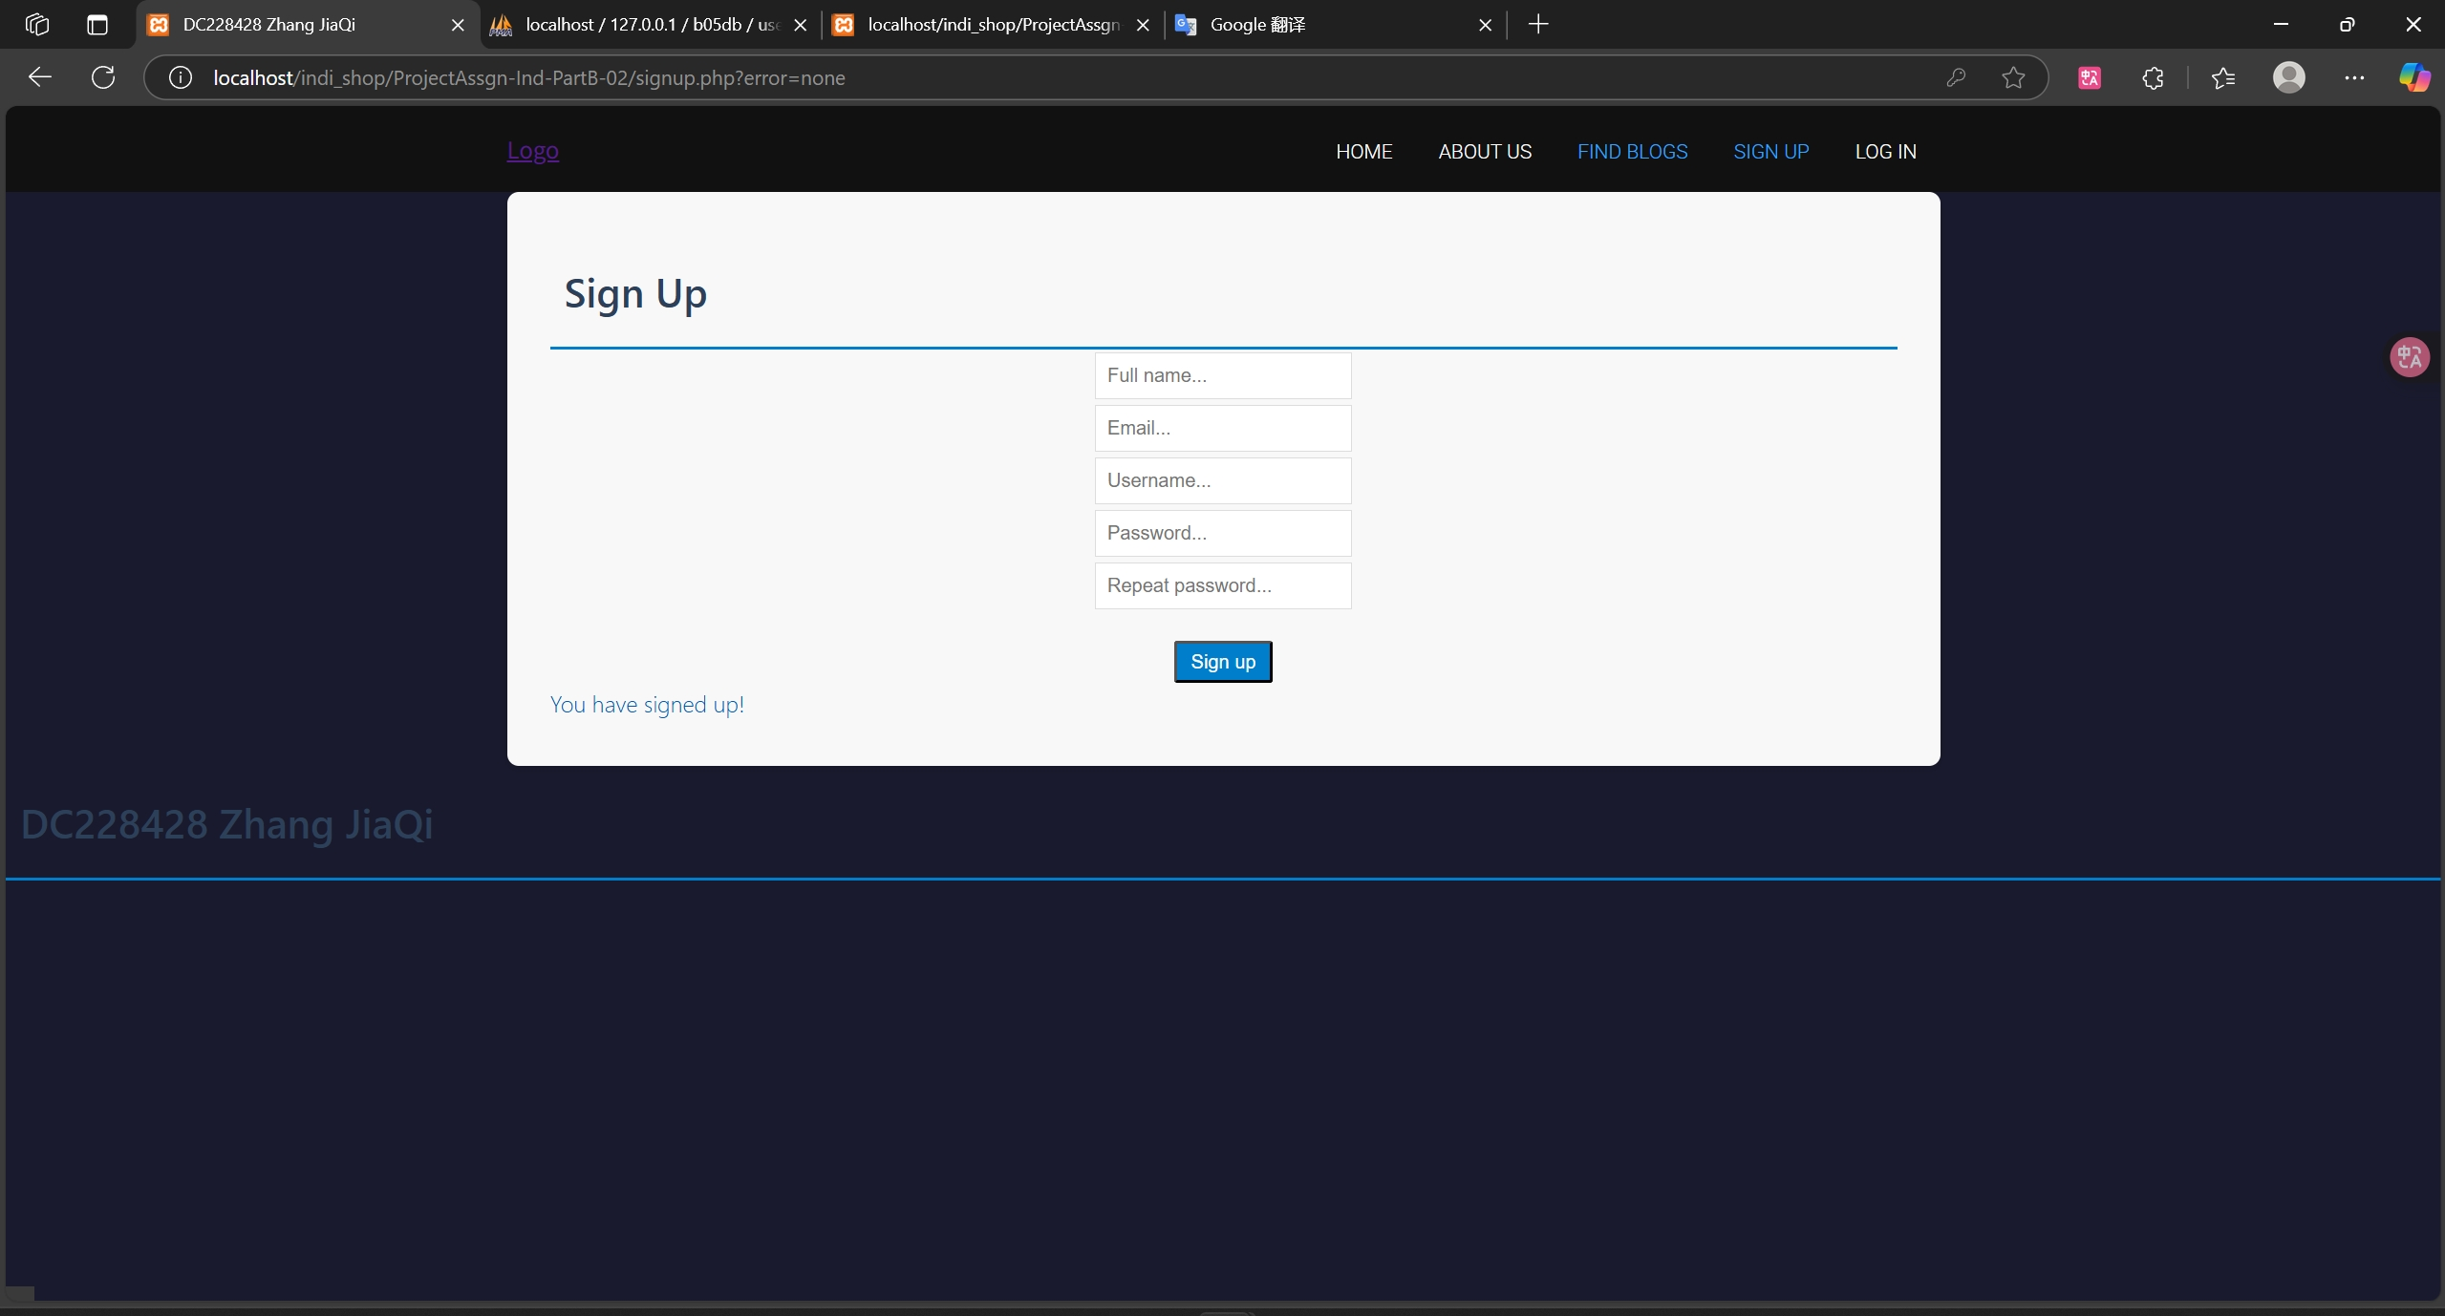
Individual Requirements Part B Practice 002 : Successful Signup

Slide 24
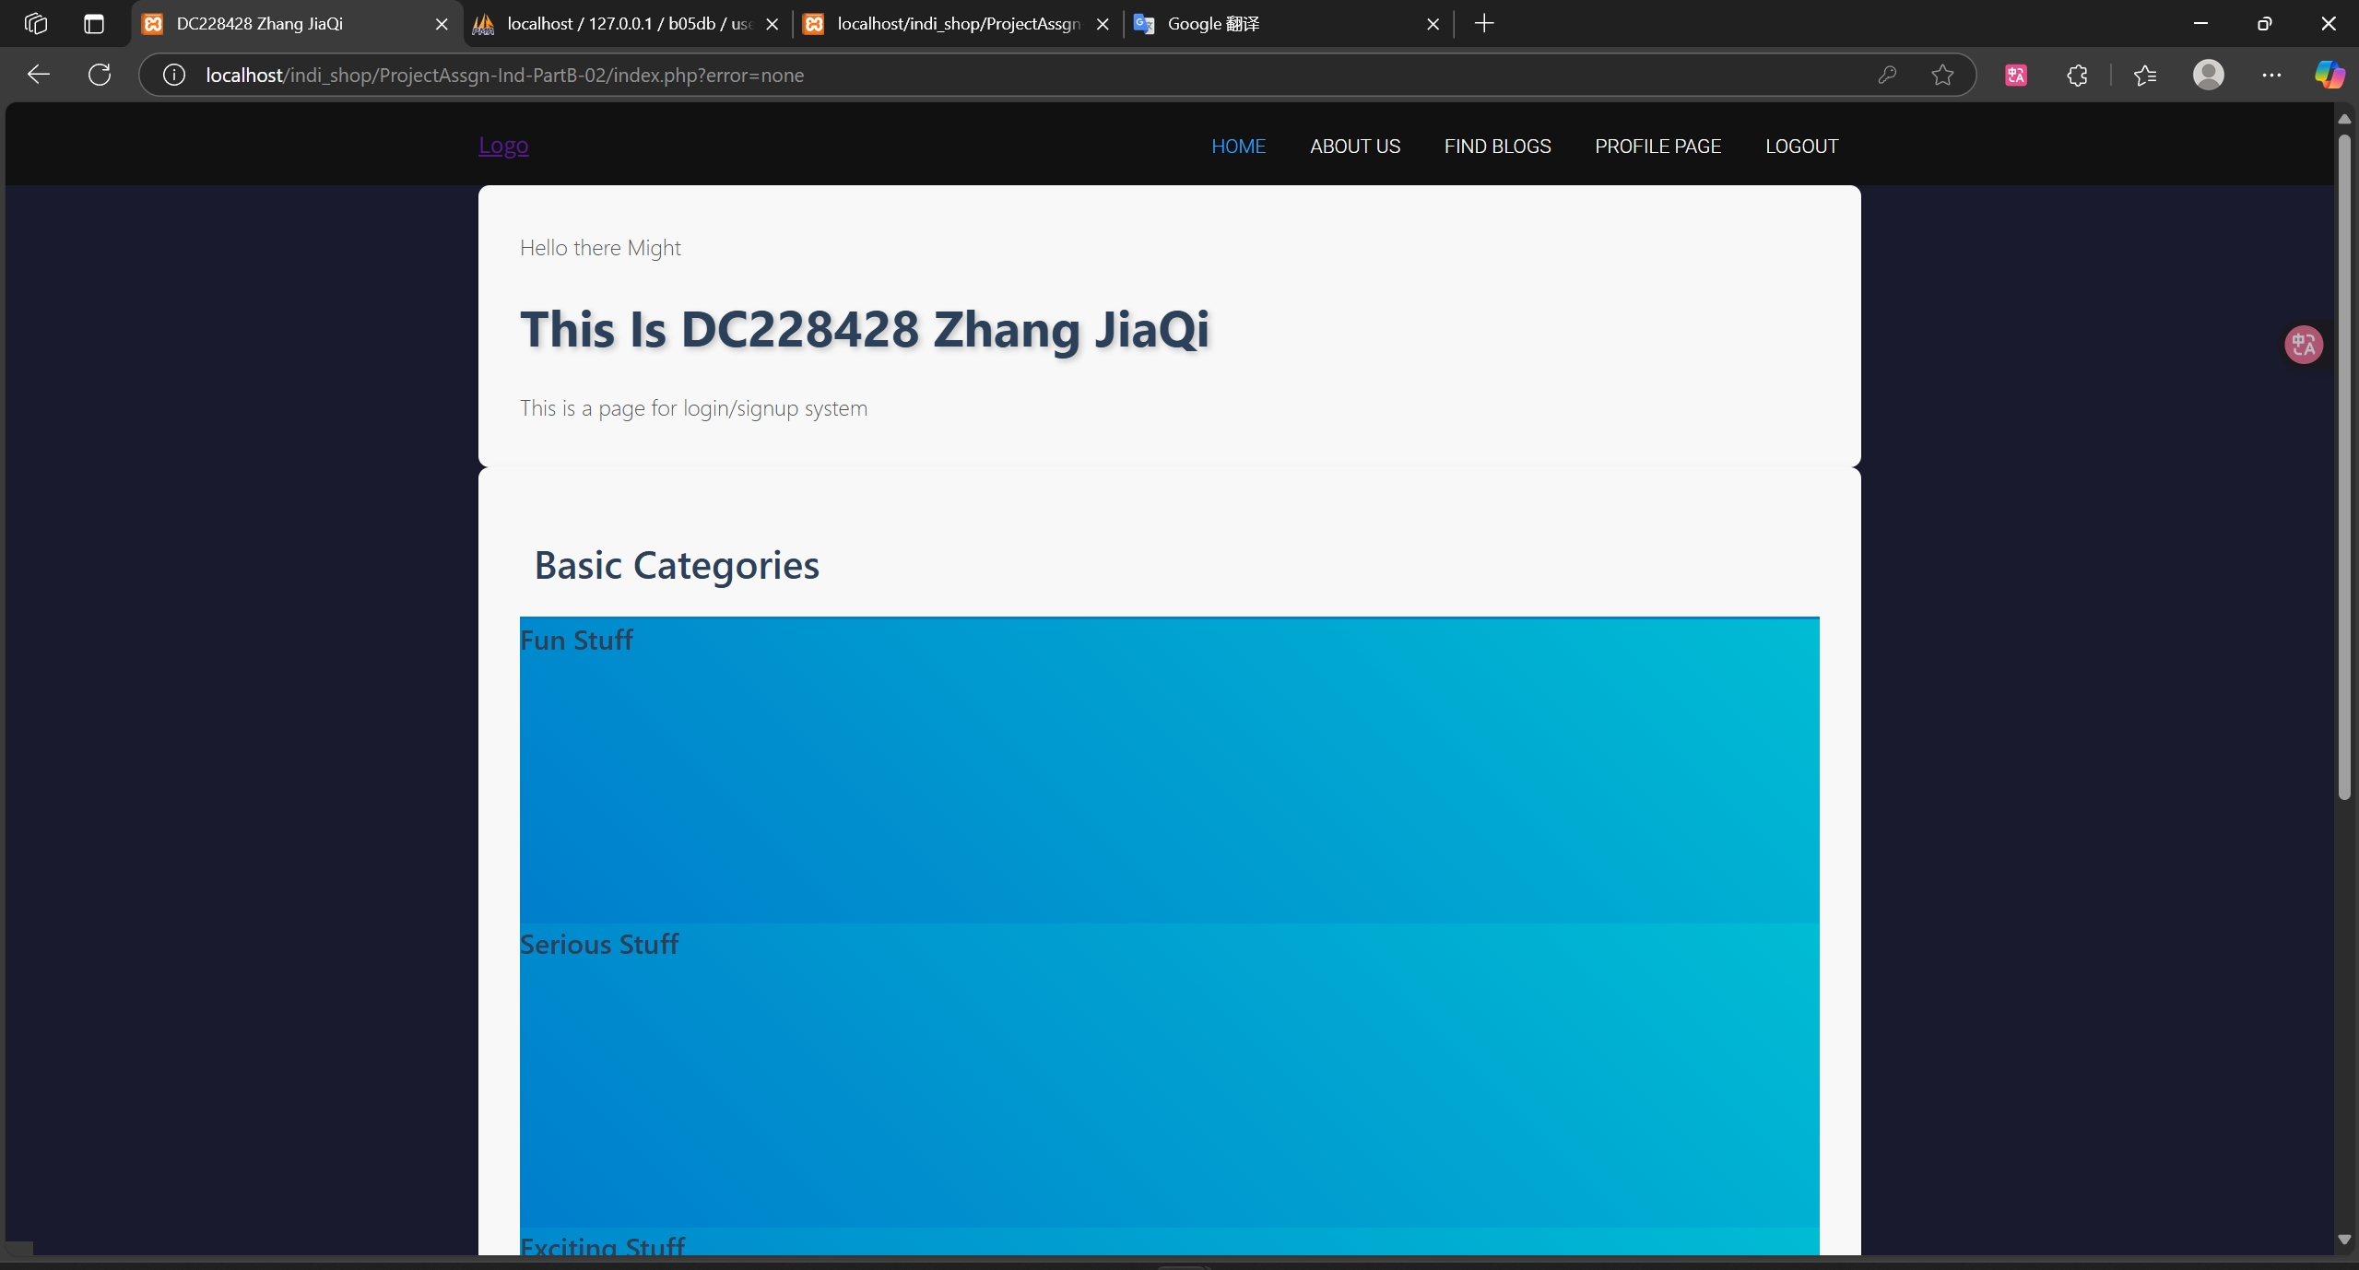
Individual Requirements Part B Practice 002 : Logged in page

Slide 25
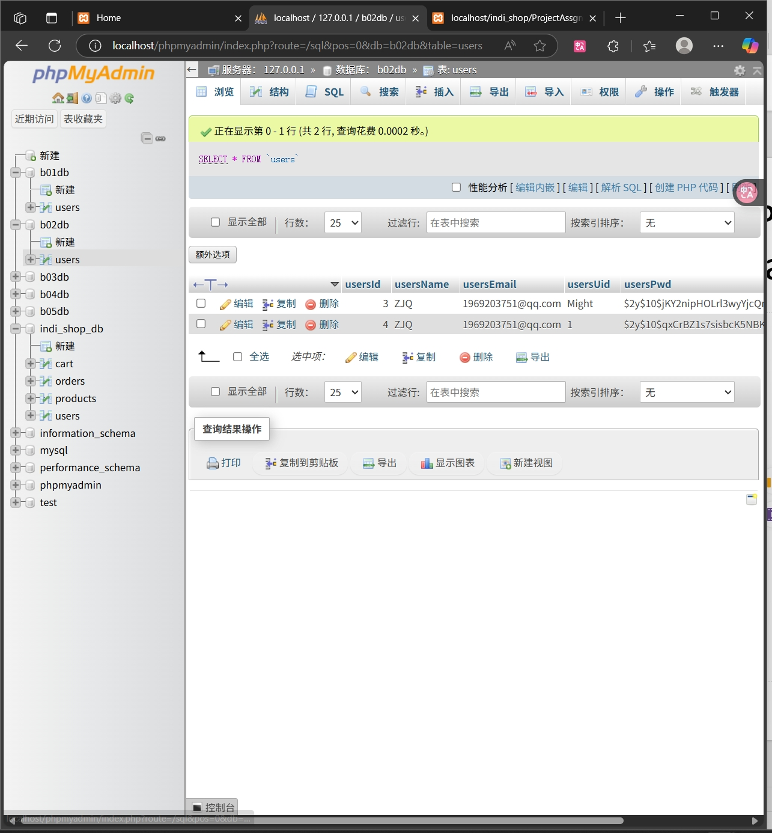
Individual Requirements Part B Practice 002 : Database

Slide 26
Individual Requirements Part B Practice 003
All files are located in indi_shop/ProjectAssgn-Ind-PartB-03
所有文件位于indi_shop/ProjectAssgn-Ind-PartB-03

Slide 27
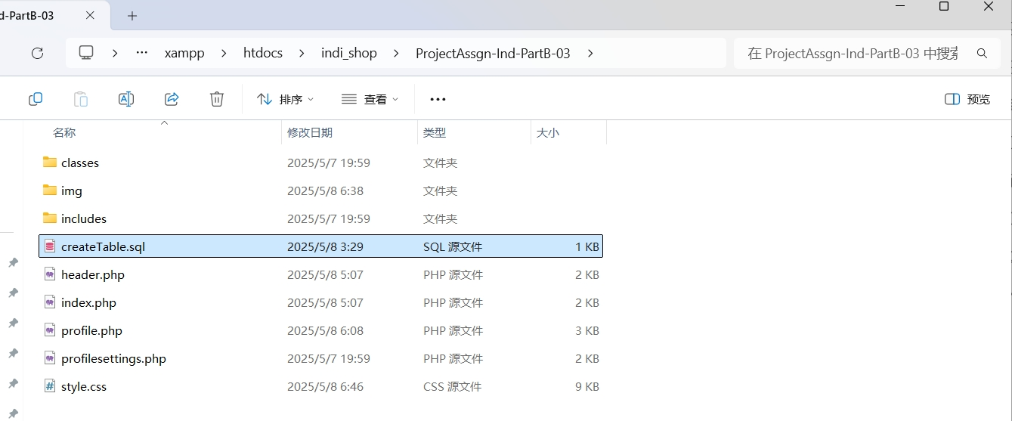
Individual Requirements Part B Practice 003
All files are located in indi_shop/ProjectAssgn-Ind-PartB-03
Start MySQL through XAMPP, create a new database in phpMyAdmin (name it "b03db", collation "utf8mb4_general_ci")
Import “indi_shop/ProjectAssgn-Ind-PartB-03/createTable.sql” and execute it.
所有文件位于indi_shop/ProjectAssgn-Ind-PartB-03
通过XAMPP启动MySQL,在phpMyAdmin中新建数据库（命名为“b03db”，排序规则“utf8mb4_general_ci”）
导入indi_shop/ProjectAssgn-Ind-PartB-03/createTable.sql并执行.

Slide 28
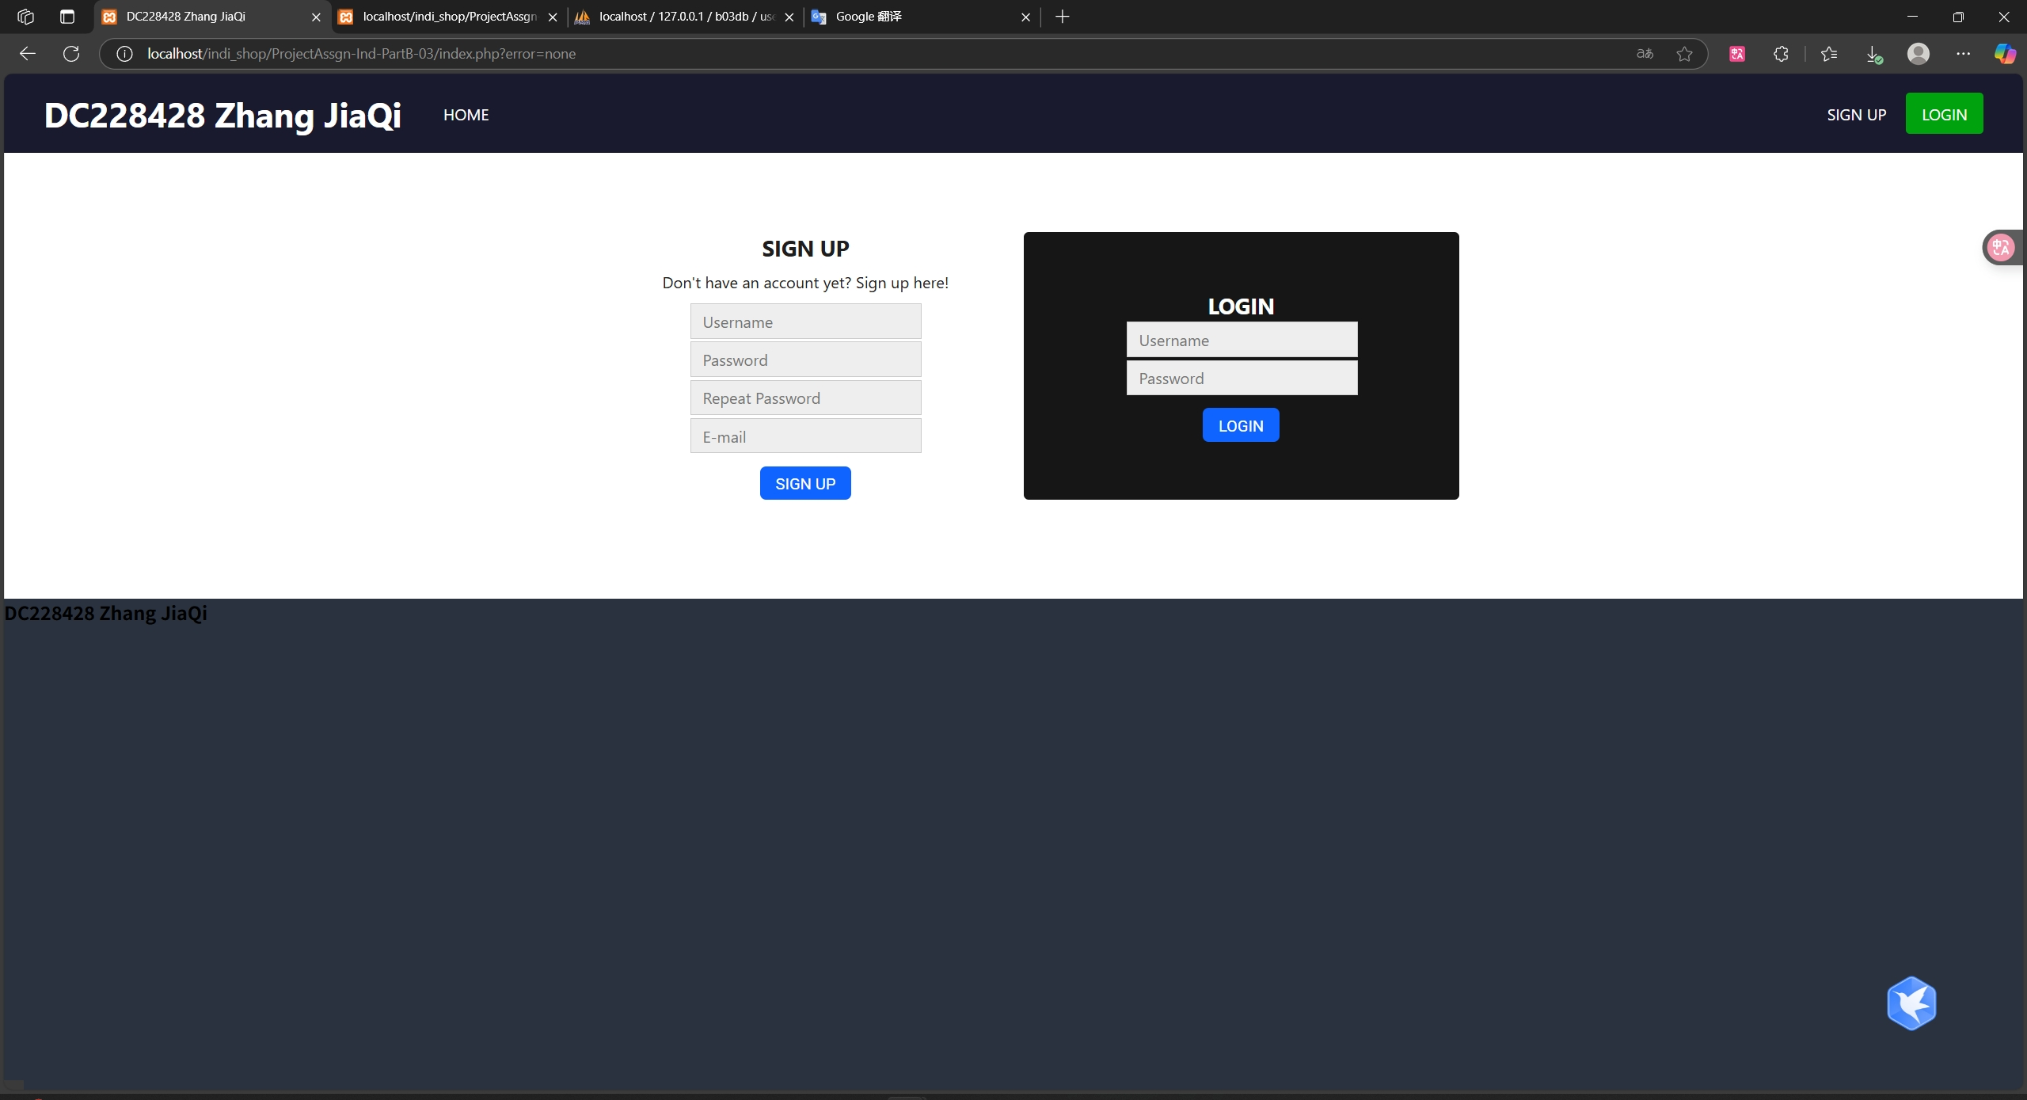
Individual Requirements Part B Practice 003
Visit localhost/indi_shop/ProjectAssgn-Ind-PartB-03/index.php To use the functions of register, log in, log out, profile, edit profile
访问localhost/indi_shop/ProjectAssgn-Ind-PartB-03/index.php以使用注册，登录，登出,个人简介，编辑简介功能

Slide 29
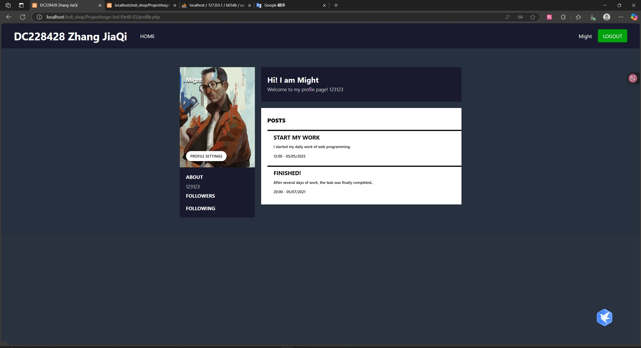
Individual Requirements Part B Practice 003 : Profile
Visit localhost/indi_shop/ProjectAssgn-Ind-PartB-03/index.php To use the functions of register, log in, log out, profile, edit profile
访问localhost/indi_shop/ProjectAssgn-Ind-PartB-03/index.php以使用注册，登录，登出,个人简介，编辑简介功能

Slide 30
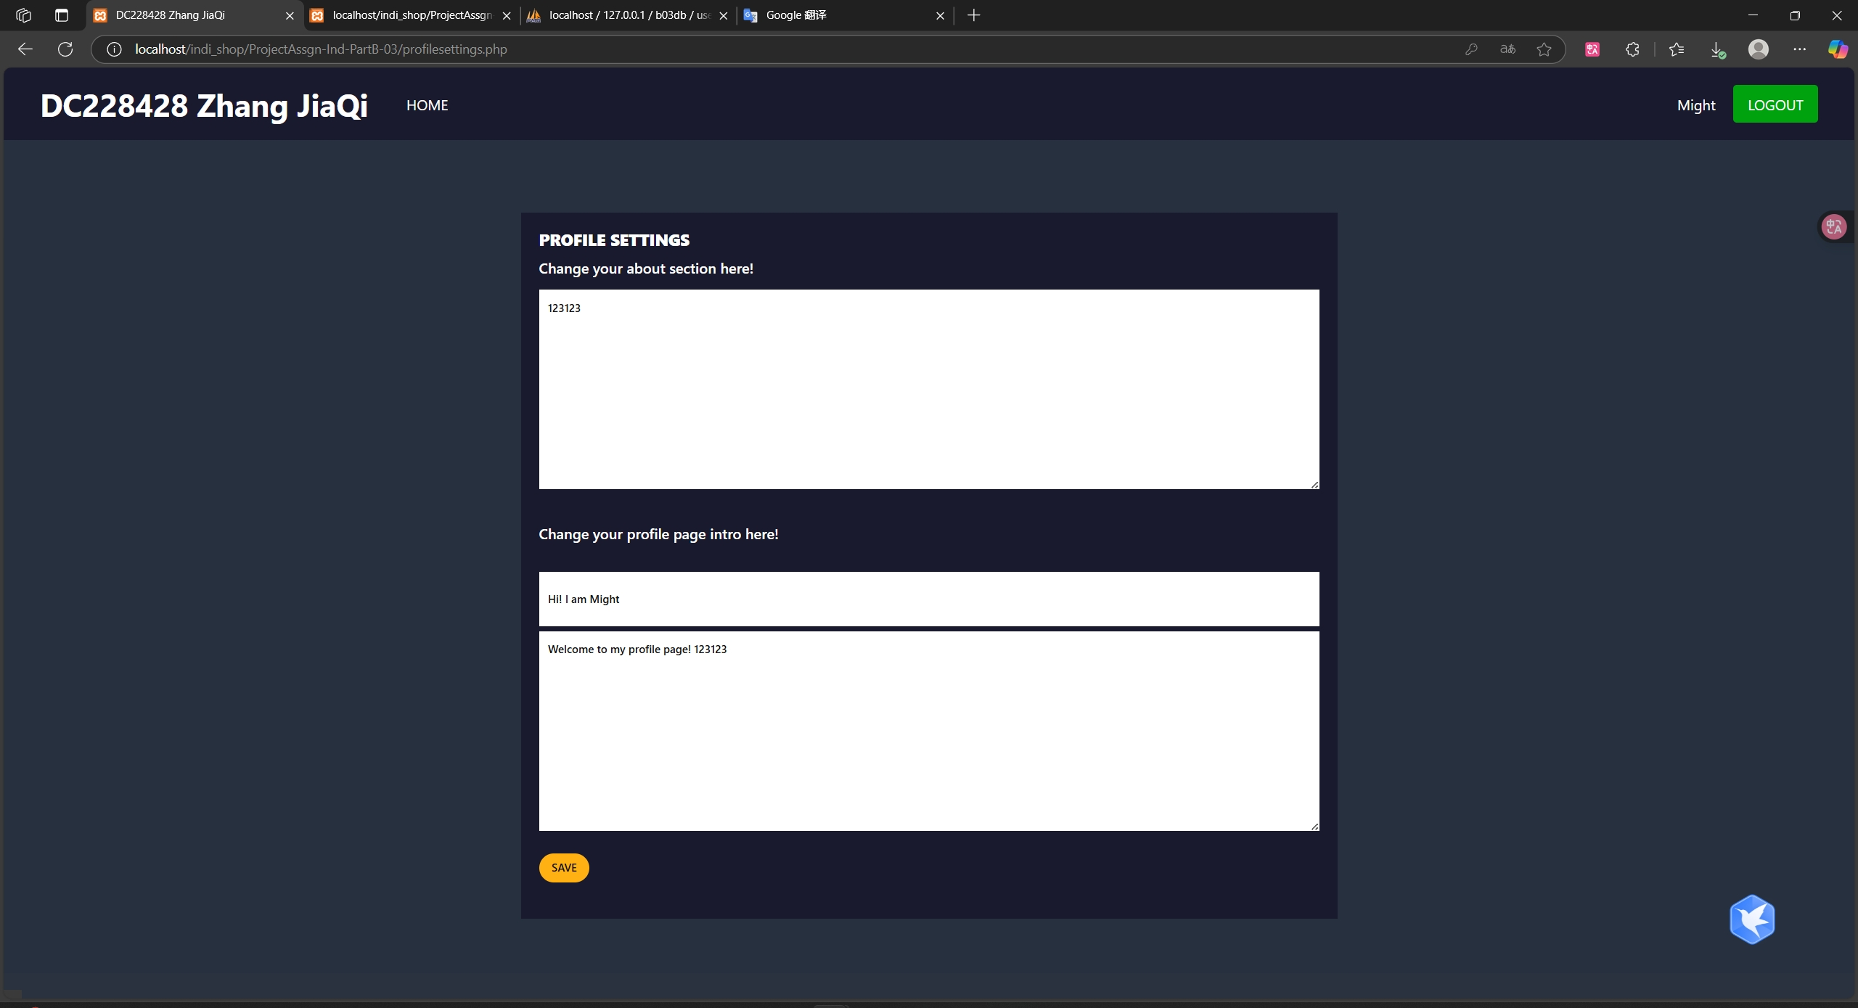
Individual Requirements Part B Practice 003 : Editing profile
Visit localhost/indi_shop/ProjectAssgn-Ind-PartB-03/index.php To use the functions of register, log in, log out, profile, edit profile
访问localhost/indi_shop/ProjectAssgn-Ind-PartB-03/index.php以使用注册，登录，登出,个人简介，编辑简介功能

Slide 31
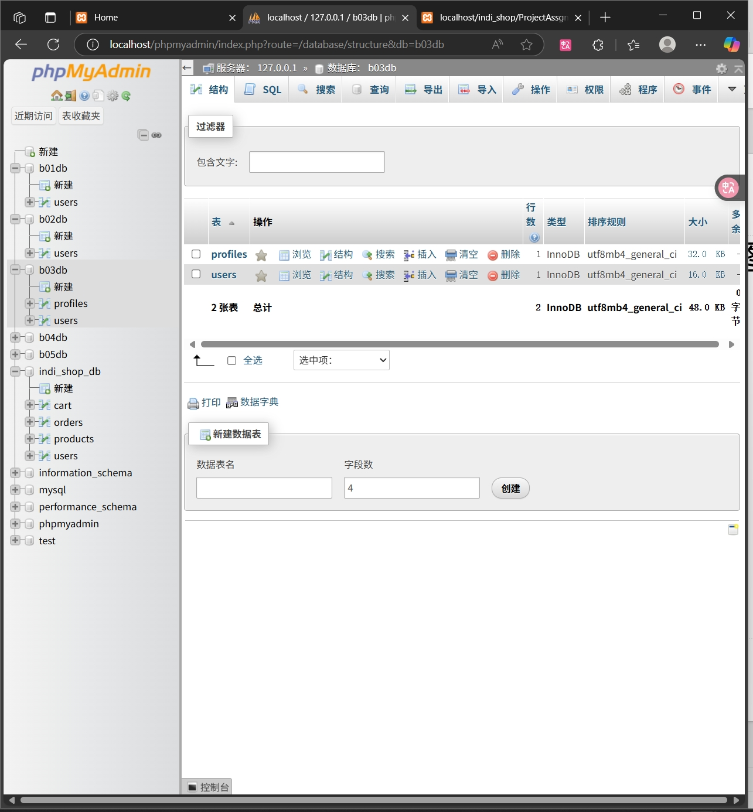
Individual Requirements Part B Practice 003 : Database

Slide 32
Individual Requirements Part B Practice 004
All files are located in indi_shop/ProjectAssgn-Ind-PartB-04
所有文件位于indi_shop/ProjectAssgn-Ind-PartB-04

Slide 33
Individual Requirements Part B Practice 004
All files are located in indi_shop/ProjectAssgn-Ind-PartB-04
Start MySQL through XAMPP, create a new database in phpMyAdmin (name it "b04db", collation "utf8mb4_general_ci")
Import “indi_shop/ProjectAssgn-Ind-PartB-04/createTable.sql” and execute it.
所有文件位于indi_shop/ProjectAssgn-Ind-PartB-04
通过XAMPP启动MySQL,在phpMyAdmin中新建数据库（命名为“b04db”，排序规则“utf8mb4_general_ci”）
导入indi_shop/ProjectAssgn-Ind-PartB-04/createTable.sql并执行.

Slide 34
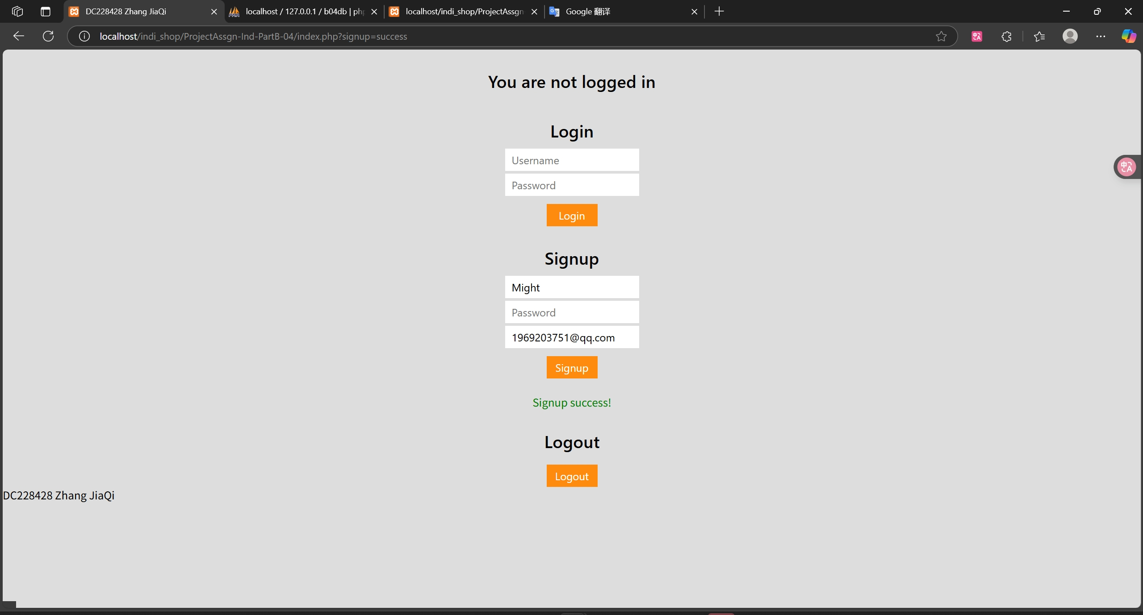
Individual Requirements Part B Practice 004 : Signup Success
Visit localhost/indi_shop/ProjectAssgn-Ind-PartB-04/index.php To use the functions of register, log in, log out
访问localhost/indi_shop/ProjectAssgn-Ind-PartB-04/index.php以使用注册，登录，登出功能

Slide 35
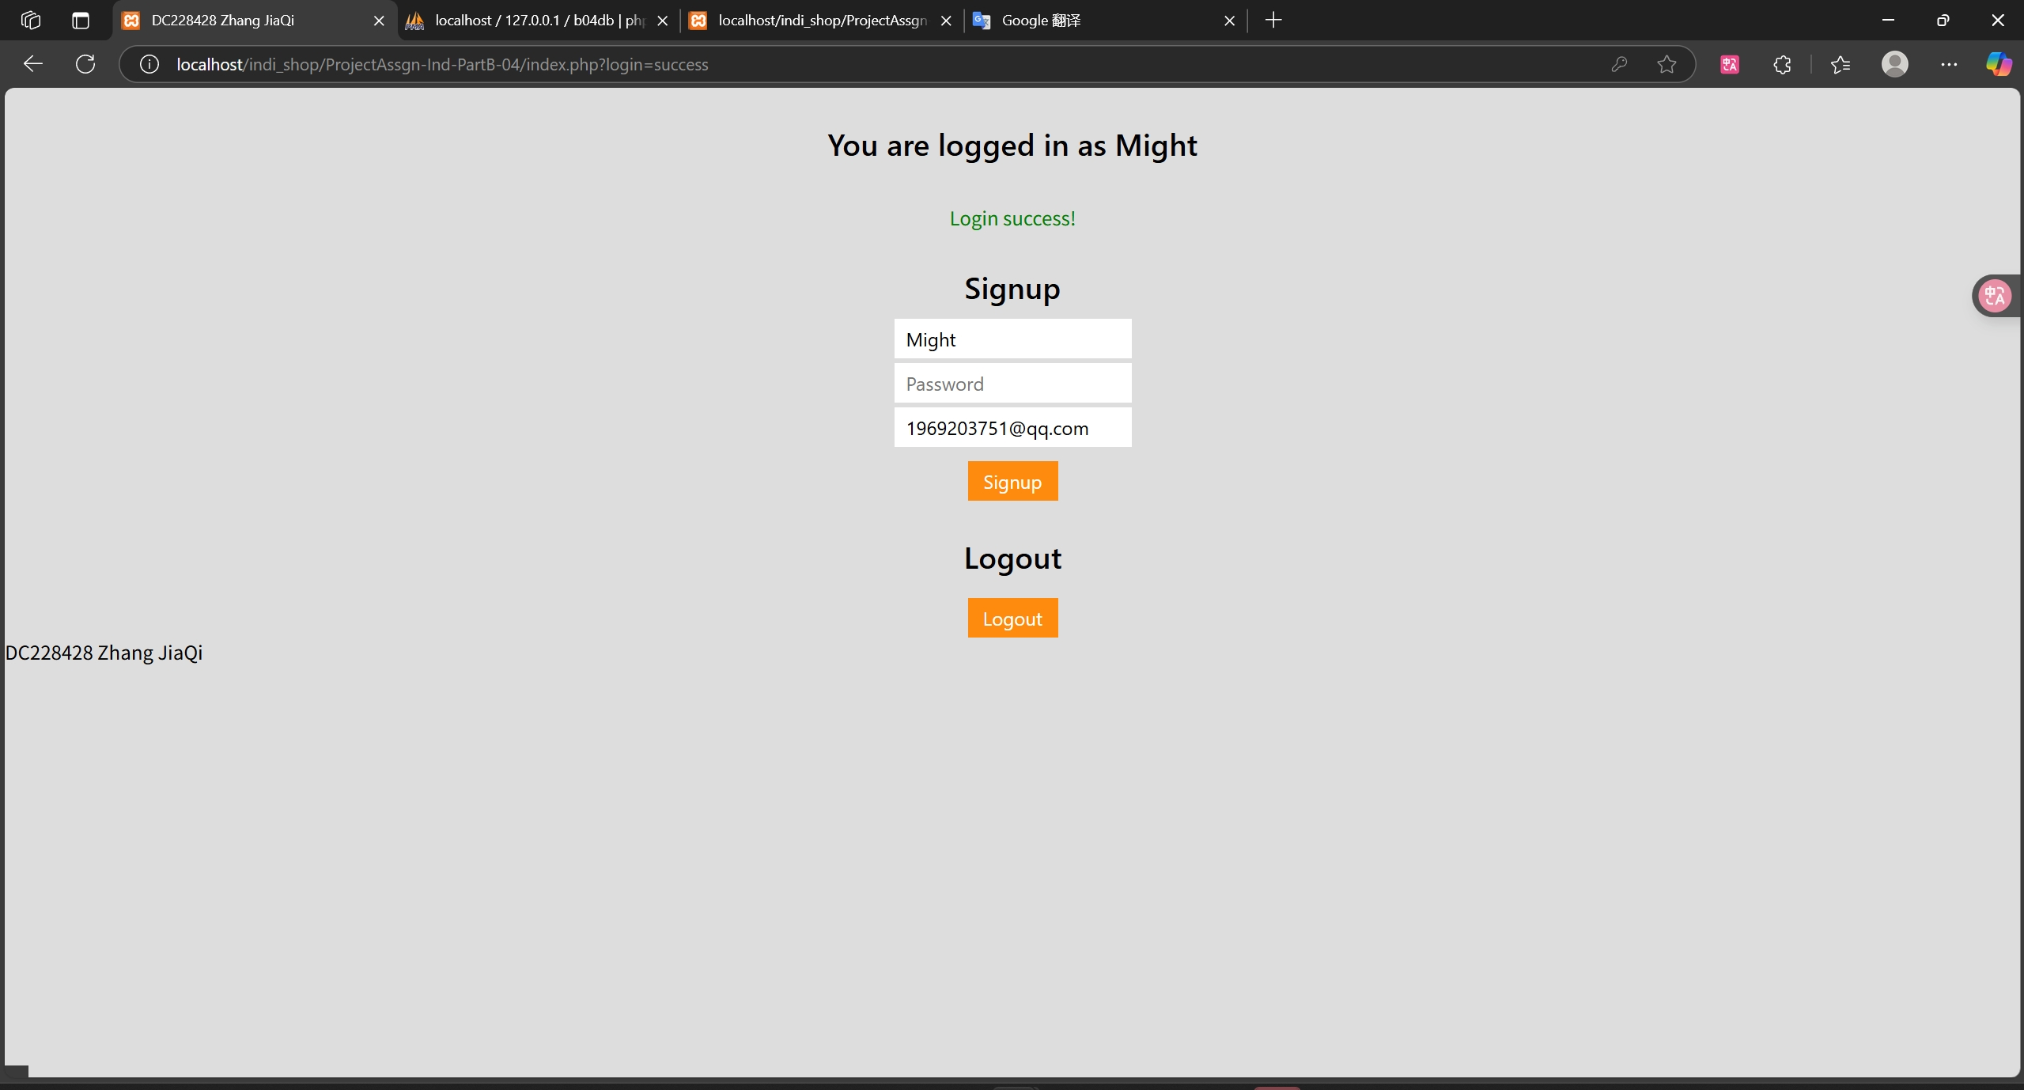
Individual Requirements Part B Practice 004 : Login Success

Slide 36
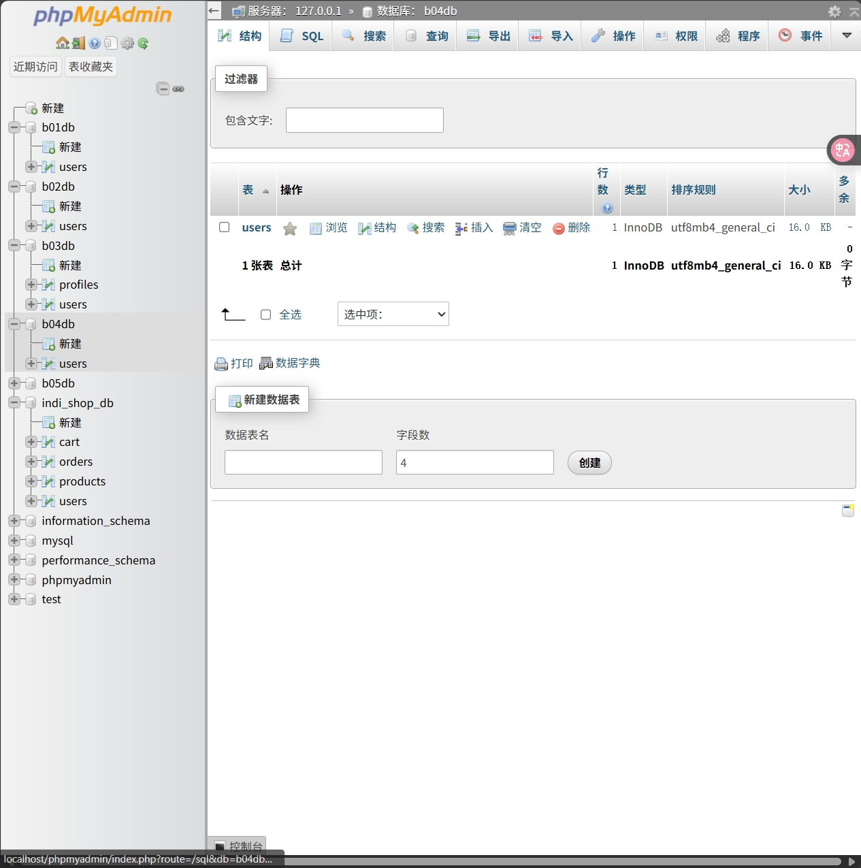
Individual Requirements Part B Practice 004 : Database

Slide 37
Individual Requirements Part B Practice 005
All files are located in indi_shop/ProjectAssgn-Ind-PartB-05
所有文件位于indi_shop/ProjectAssgn-Ind-PartB-05

Slide 38
Individual Requirements Part B Practice 005
All files are located in indi_shop/ProjectAssgn-Ind-PartB-05
Start MySQL through XAMPP, create a new database in phpMyAdmin (name it "b05db", collation "utf8mb4_general_ci")
Import “indi_shop/ProjectAssgn-Ind-PartB-05/createTable.sql” and execute it.
所有文件位于indi_shop/ProjectAssgn-Ind-PartB-05
通过XAMPP启动MySQL,在phpMyAdmin中新建数据库（命名为“b05db”，排序规则“utf8mb4_general_ci”）
导入indi_shop/ProjectAssgn-Ind-PartB-05/createTable.sql并执行.

Slide 39
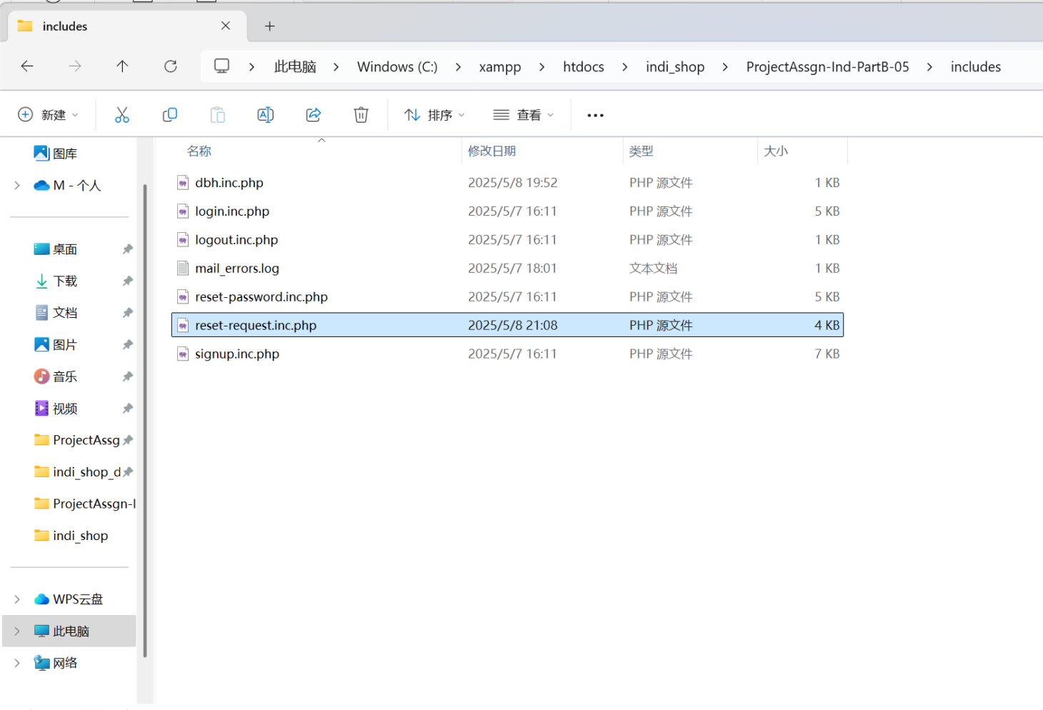
Individual Requirements Part B Practice 005
程序默认存在以下路径htdocs/indi_shop/ProjectAssgn-Ind-PartB-05/includes/reset-request.inc.php
如果你修改了路径，请确保indi_shop/ProjectAssgn-Ind-PartB-05/includes/reset-request.inc.php中第15行$url = "http://".$_SERVER['HTTP_HOST']."/indi_shop/ProjectAssgn-Ind-PartB-05/create-new-password.php?selector=".$selector."&validator=".$validator;路径能正确导向ProjectAssgn-Ind-PartB-05/create-new-password.php，否则重置密码链接会导致无法找到url

Slide 40
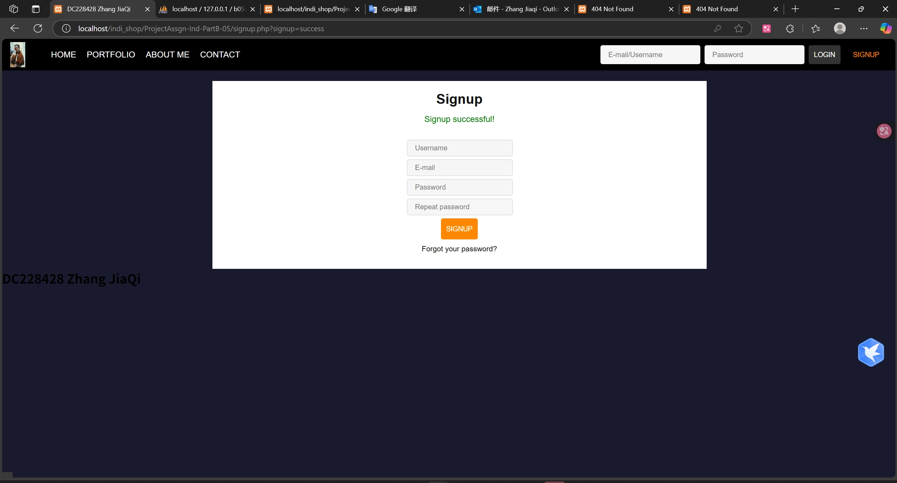
Individual Requirements Part B Practice 005 : Signup Success
Visit localhost/indi_shop/ProjectAssgn-Ind-PartB-05/index.php To use the registration, login, logout, reset password functions
访问localhost/indi_shop/ProjectAssgn-Ind-PartB-05/index.php以使用注册，登录，登出,重置密码功能

Slide 41
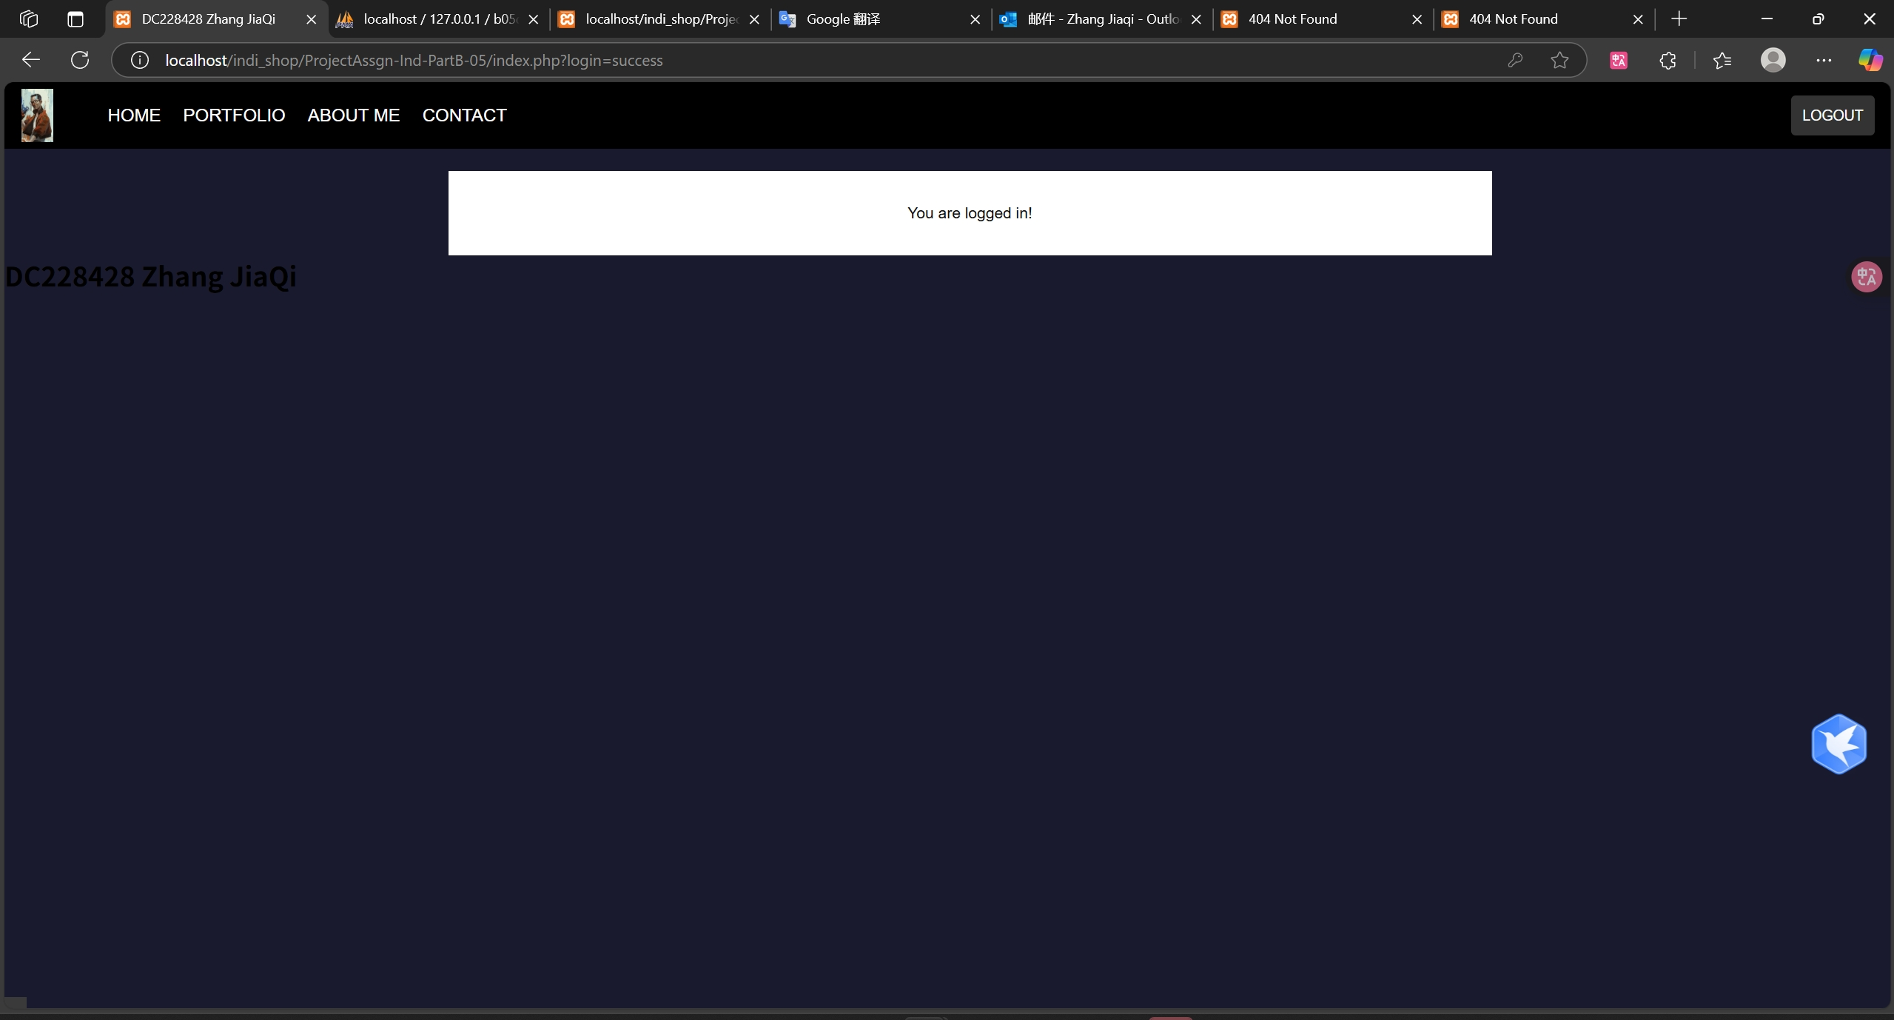
Individual Requirements Part B Practice 005 : Login Success

Slide 42
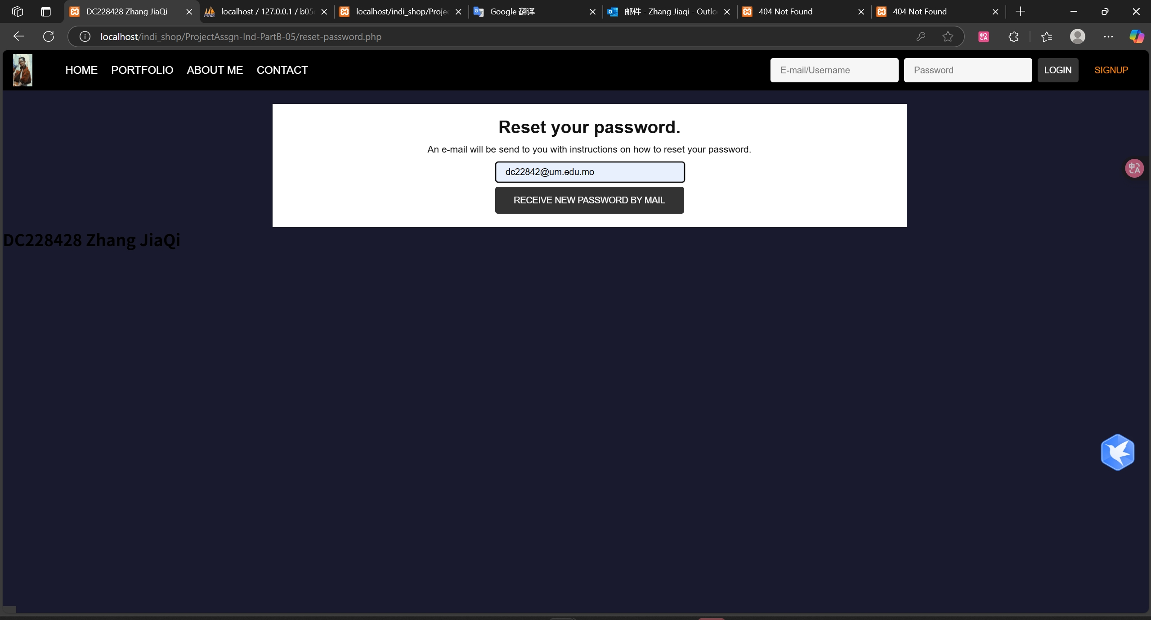
Individual Requirements Part B Practice 005 : Send email to reset password

Slide 43
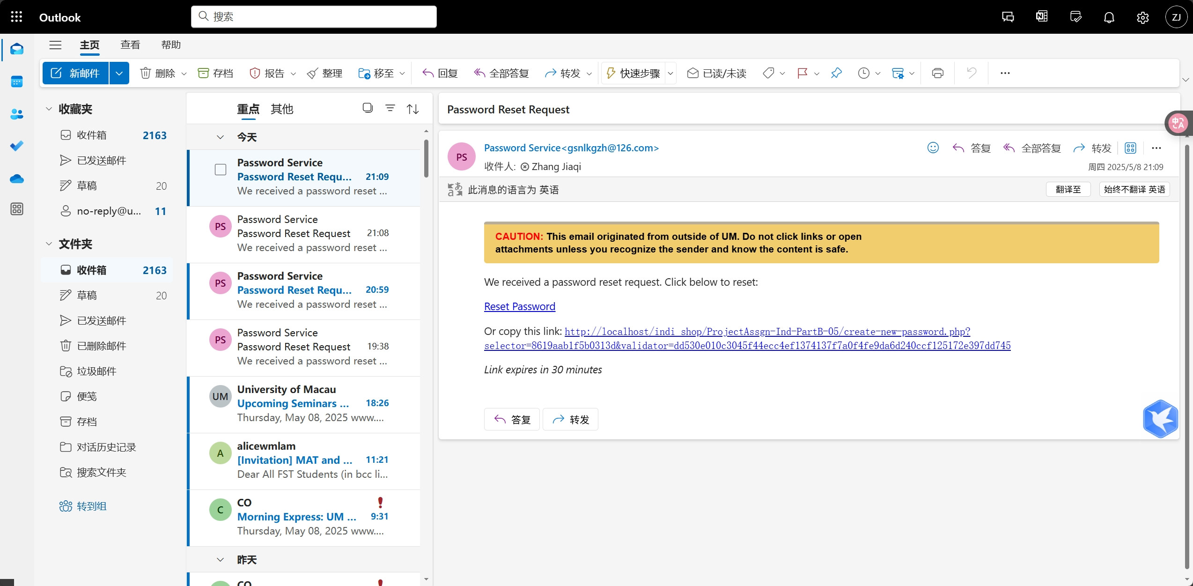
Individual Requirements Part B Practice 005 : Send email to reset password

Slide 44
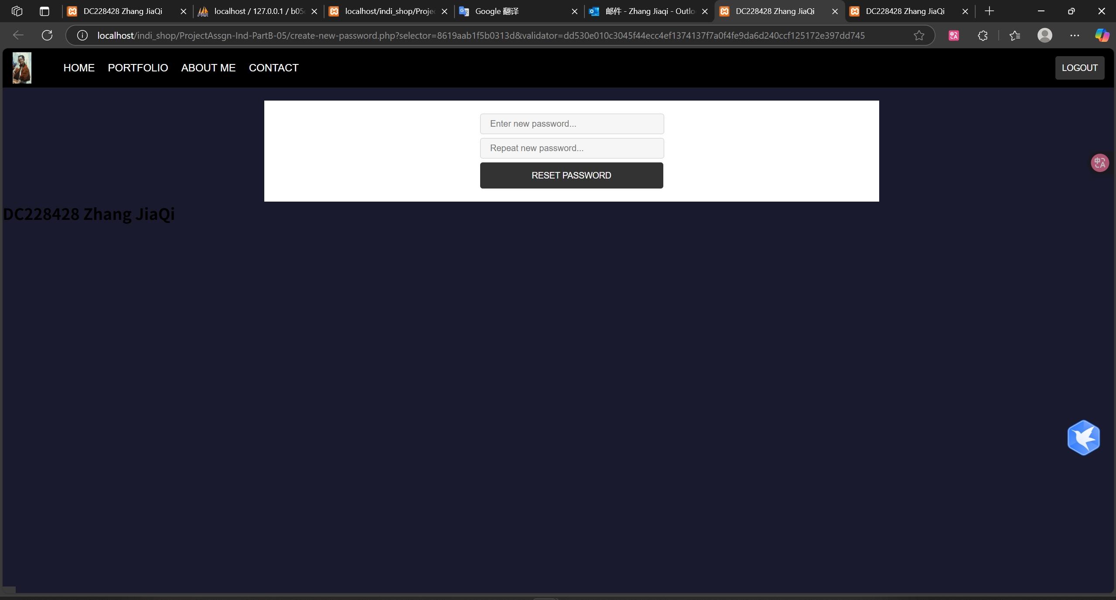
Individual Requirements Part B Practice 005 : Send email to reset password

Slide 45
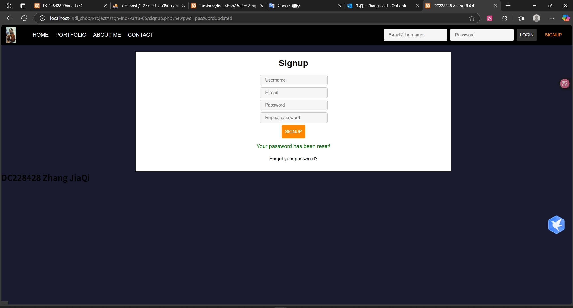
Individual Requirements Part B Practice 005 : Send email to reset password

Slide 46
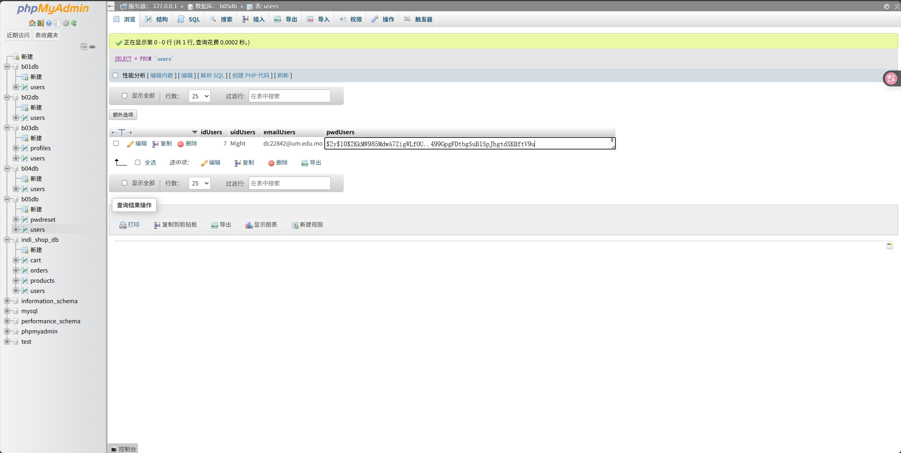
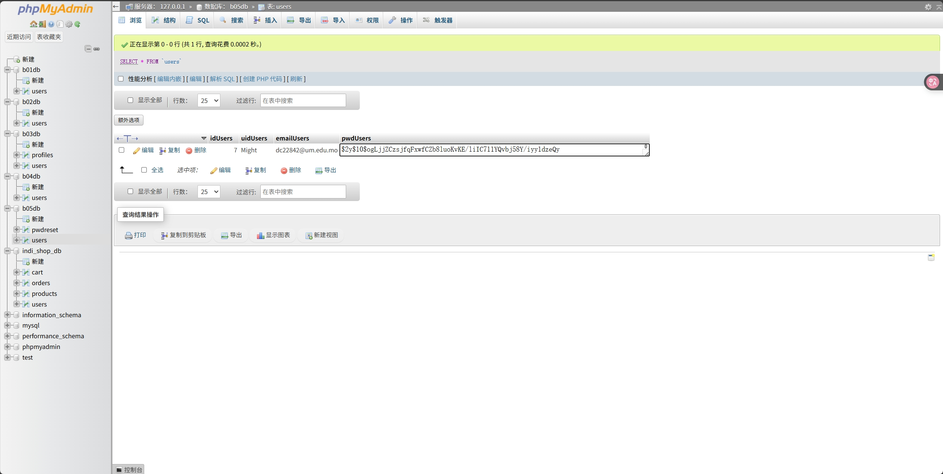
Individual Requirements Part B Practice 005 : Send email to reset password
password before reset
password after reset

Slide 47
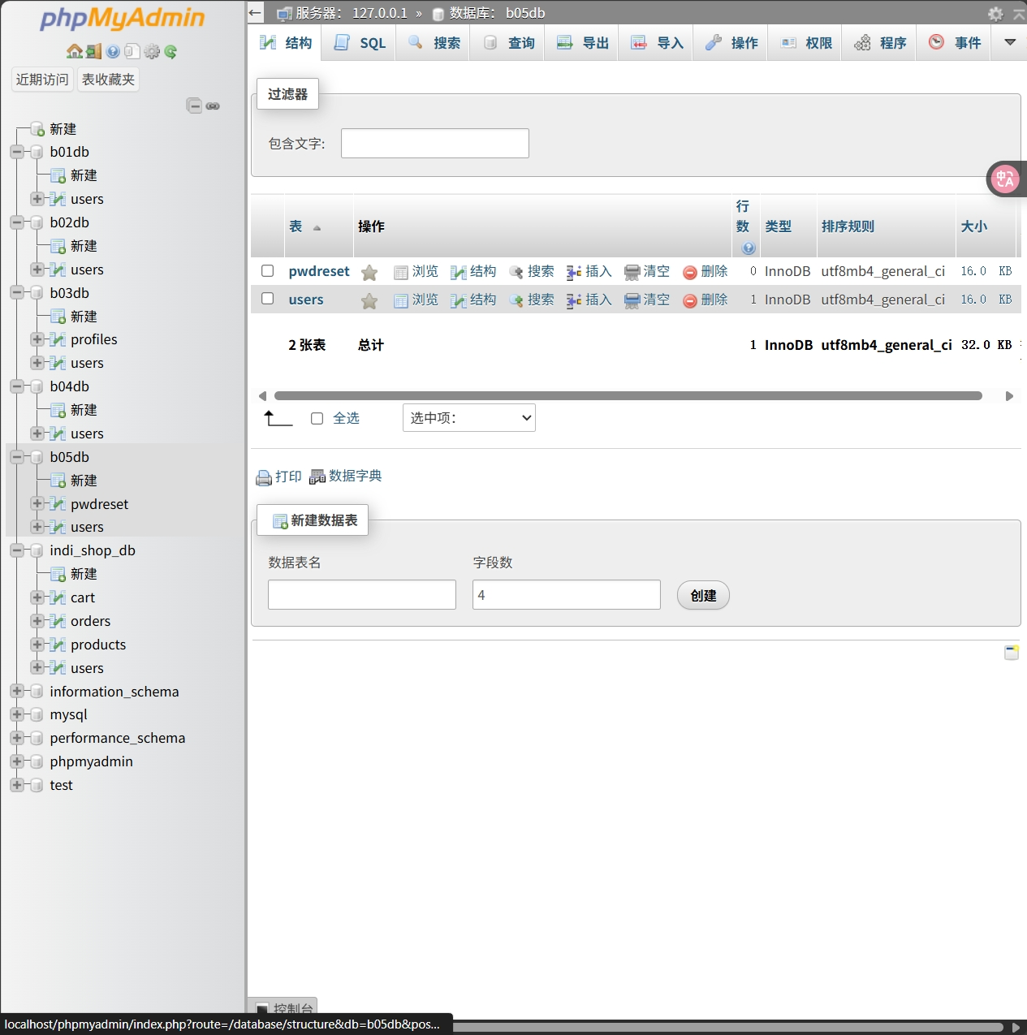
Individual Requirements Part B Practice 005 : Database

